Slide 1
CPU Scheduling

Slide 2
Outline
Basic Concepts
Scheduling Criteria
Scheduling Algorithms
Thread Scheduling
Multi-Processor Scheduling
Real-Time CPU Scheduling
Operating Systems Examples
Algorithm Evaluation

Slide 3
Objectives
Describe various CPU scheduling algorithms
Assess CPU scheduling algorithms based on scheduling criteria
Explain the issues related to multiprocessor and multicore scheduling
Describe various real-time scheduling algorithms
Describe the scheduling algorithms used in the Windows, Linux, and Solaris operating systems
Apply modeling and simulations to evaluate CPU scheduling algorithms

Slide 4
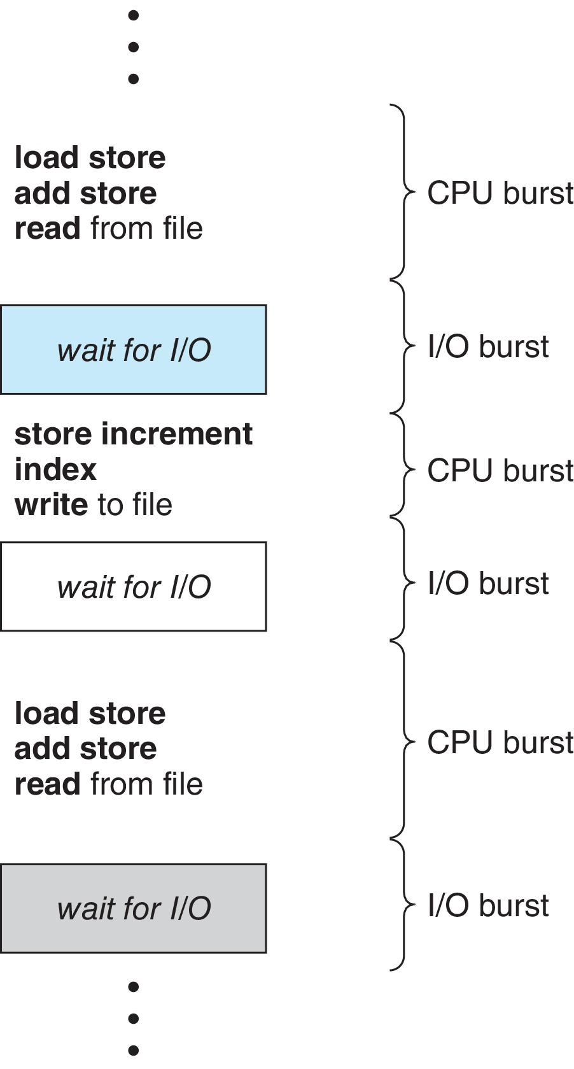
Basic Concepts
Maximum CPU utilization obtained with multiprogramming
CPU–I/O Burst Cycle – Process execution consists of a cycle of CPU execution and I/O wait
CPU burst followed by I/O burst
CPU burst distribution is of main concern

Slide 5
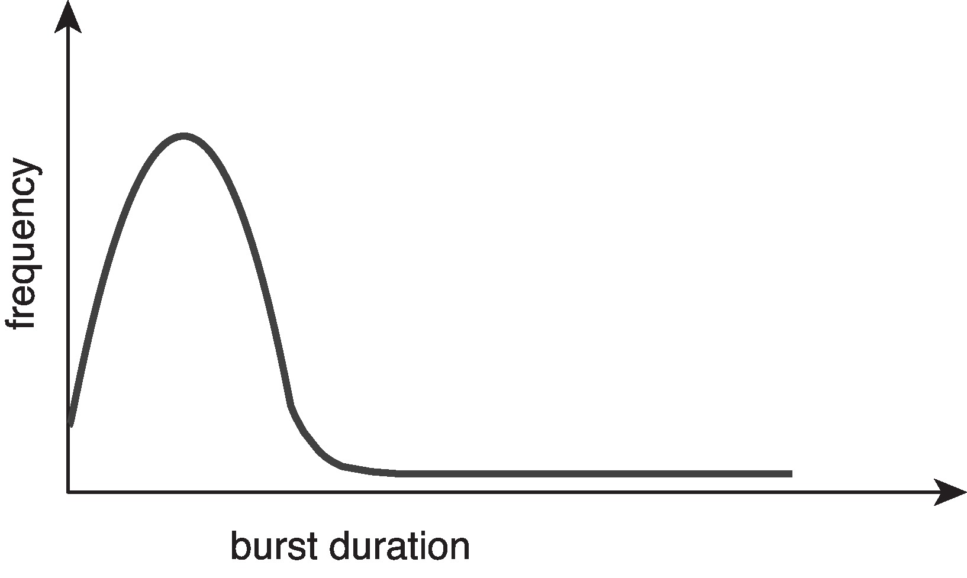
Histogram of CPU-burst Times
Large number of short bursts
Small number of longer bursts

Slide 6
CPU Scheduler
The CPU scheduler selects from among the processes in ready queue, and allocates a CPU core to one of them
  Queue may be ordered in various ways
CPU scheduling decisions may take place when a process:
  1. Switches from running to waiting state
  2. Switches from running to ready state
  3. Switches from waiting to ready
  Terminates
For situations 1 and 4, there is no choice in terms of scheduling. A new process (if one exists in the ready queue) must be selected for execution.
For situations 2 and 3, however, there is a choice.

Slide 7
Preemptive and Nonpreemptive Scheduling
When scheduling takes place only under circumstances 1 and 4, the scheduling scheme is nonpreemptive.
Otherwise, it is preemptive.
Under Nonpreemptive scheduling, once the CPU has been allocated to a process, the process keeps the CPU until it releases it either by terminating or by switching to the waiting state.
Virtually all modern operating systems including Windows, MacOS, Linux, and UNIX use preemptive scheduling algorithms.

Slide 8
Preemptive Scheduling and Race Conditions
Preemptive scheduling can result in race conditions when data are shared among several processes.
Consider the case of two processes that share data. While one process is updating the data, it is preempted so that the second process can run. The second process then tries to read the data, which are in an inconsistent state.
This issue will be explored in detail in Chapter 6.

Slide 9
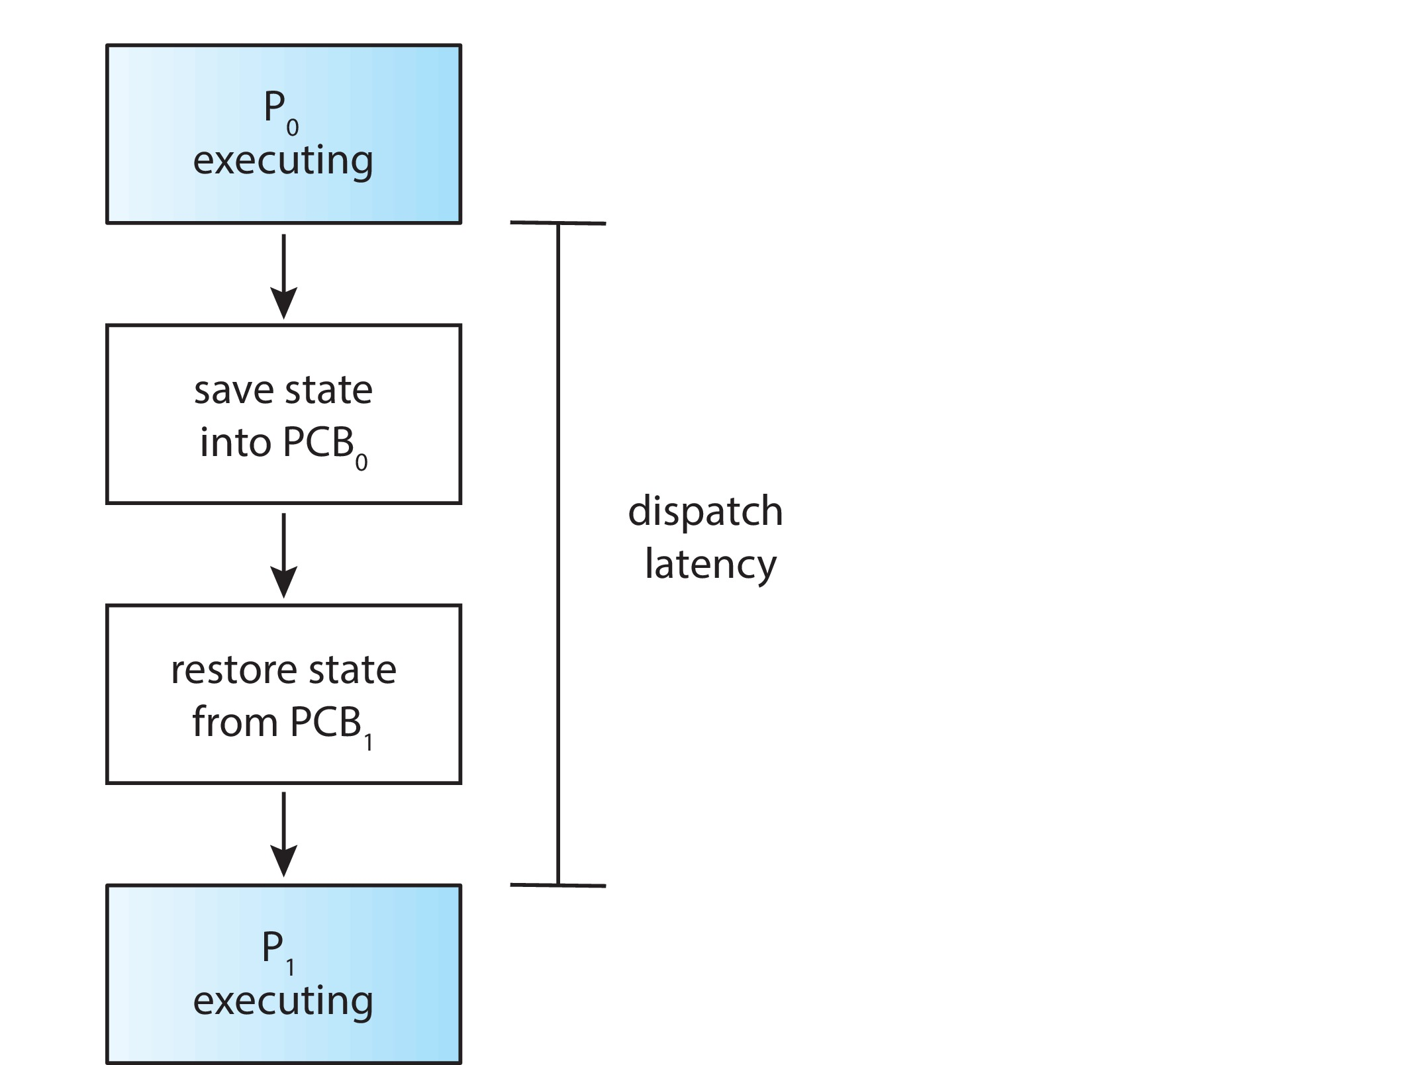
Dispatcher
Dispatcher module gives control of the CPU to the process selected by the CPU scheduler; this involves:
  Switching context
  Switching to user mode
  Jumping to the proper location in the user program to restart that program
Dispatch latency – time it takes for the dispatcher to stop one process and start another running

Slide 10
Scheduling Criteria
CPU utilization – keep the CPU as busy as possible
Throughput – Number of processes that complete their execution per time unit
Turnaround time – amount of time to execute a particular process
Waiting time – amount of time a process has been waiting in the ready queue
Response time – amount of time it takes from when a request was submitted until the first response is produced.

Slide 11
Scheduling Algorithm Optimization Criteria
Maximize CPU utilization
Maximize throughput
Minimize turnaround time
Minimize waiting time
Minimize response time

Slide 12
First- Come, First-Served (FCFS) Scheduling
Process Burst Time
P₁ 24
P₂ 3
P₃ 3
Suppose that the processes arrive in the order: P₁ , P₂ , P₃ at time 0

Slide 13
First- Come, First-Served (FCFS) Scheduling
Process Burst Time
P₁ 24
P₂ 3
P₃ 3
Suppose that the processes arrive in the order: P₁ , P₂ , P₃
The Gantt Chart for the schedule is:
Waiting time for P₁ = 0; P₂ = 24; P₃ = 27
Average waiting time: (0 + 24 + 27)/3 = 17

Slide 14
FCFS Scheduling (Cont.)
Suppose that the processes arrive in the order:
P₂ , P₃ , P₁
The Gantt chart for the schedule is:
Waiting time for P₁ = 6; P₂ = 0; P₃ = 3
Average waiting time: (6 + 0 + 3)/3 = 3
Much better than previous case
Convoy effect - short process behind long process
  Consider one CPU-bound and many I/O-bound processes

Slide 15
Shortest-Job-First (SJF) Scheduling
Associate with each process the length of its next CPU burst
  Use these lengths to schedule the process with the shortest time
SJF is optimal – gives minimum average waiting time for a given set of processes
Preemptive version called shortest-remaining-time-first
How do we determine the length of the next CPU burst?
  Could ask the user
  Estimate

Slide 16
Example of SJF
Process Burst Time
P₁ 6
P₂ 8
P₃ 7
P₄ 3

Slide 17
Example of SJF
Process Burst Time
P₁ 6
P₂ 8
P₃ 7
P₄ 3
Gantt chart
Average waiting time = (3 + 16 + 9 + 0) / 4 = 7

Slide 18
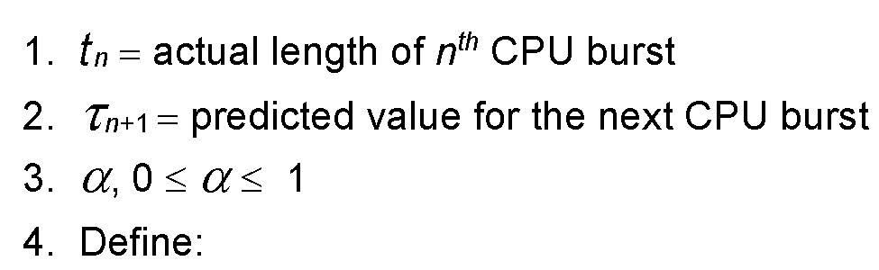

Determining Length of Next CPU Burst
Can only estimate the length – should be similar to the previous one
  Then pick process with shortest predicted next CPU burst
Can be done by using the length of previous CPU bursts, using exponential averaging
Commonly, α set to ½

Slide 19
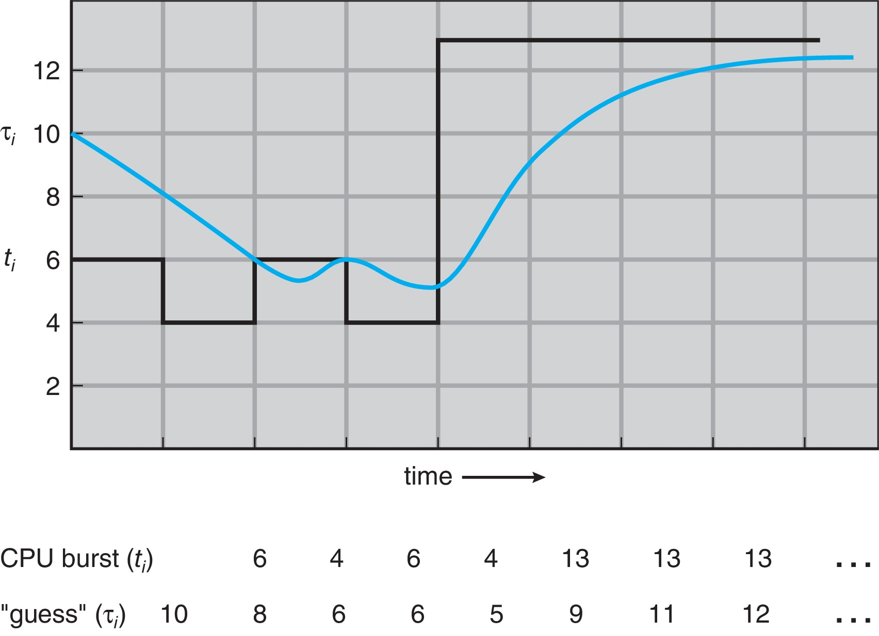
Prediction of the Length of the Next CPU Burst

Slide 20
Examples of Exponential Averaging
α =0
  τ_{n+1} = τ_{n}
  Recent history does not count
α =1
  τ_{n+1} = α t_{n}
  Only the actual last CPU burst counts
If we expand the formula, we get:
    τ_{n+1} = α t_{n}+(1 - α)α t_{n} ₋₁ + …
    +(1 - α )^{j} α t_{n} _{-j} + …
    +(1 - α )^{n +1} τ₀
Since both α and (1 - α) are less than or equal to 1, each successor predecessor term has less weight than its predecessor

Slide 21
Shortest Remaining Time First Scheduling
Preemptive version of SJF
Whenever a new process arrives in the ready queue, the decision on which process to schedule next is redone using the SJF algorithm.
Is SRT more “optimal” than SJF in terms of the minimum average waiting time for a given set of processes?

Slide 22
Example of Shortest-remaining-time-first
Now we add the concepts of varying arrival times and preemption to the analysis
Process i Arrival TimeT Burst Time
P₁ 0 8
P₂ 1 4
P₃ 2 9
P₄ 3 5
Preemptive SJF Gantt Chart
Average waiting time = [(10-1)+(1-1)+(17-2)+(5-3)]/4 = 26/4 = 6.5

Slide 23
Round Robin (RR)
Each process gets a small unit of CPU time (time quantum q), usually 10-100 milliseconds. After this time has elapsed, the process is preempted and added to the end of the ready queue.
If there are n processes in the ready queue and the time quantum is q, then each process gets 1/n of the CPU time in chunks of at most q time units at once. No process waits more than (n-1)q time units.
Timer interrupts every quantum to schedule next process
Performance
  q large ⇒ FIFO (FCFS)
  q small ⇒ RR
Note that q must be large with respect to context switch, otherwise overhead is too high

Slide 24
Example of RR with Time Quantum = 4
Process Burst Time
P₁ 24
P₂ 3
P₃ 3
The Gantt chart is:
Typically, higher average turnaround than SJF, but better response
q should be large compared to context switch time
  q usually 10 milliseconds to 100 milliseconds,
  Context switch < 10 microseconds

Slide 25
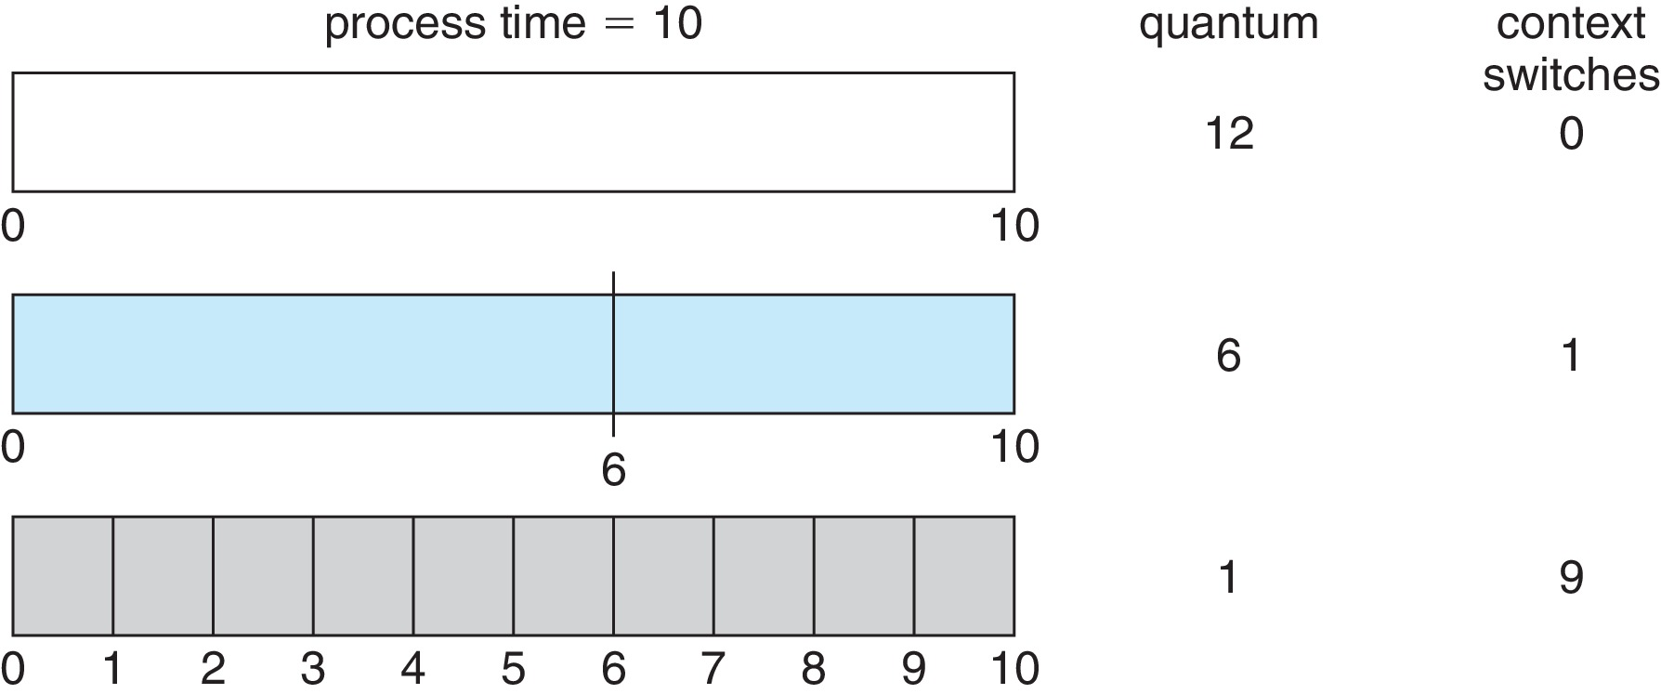
Time Quantum and Context Switch Time

Slide 26
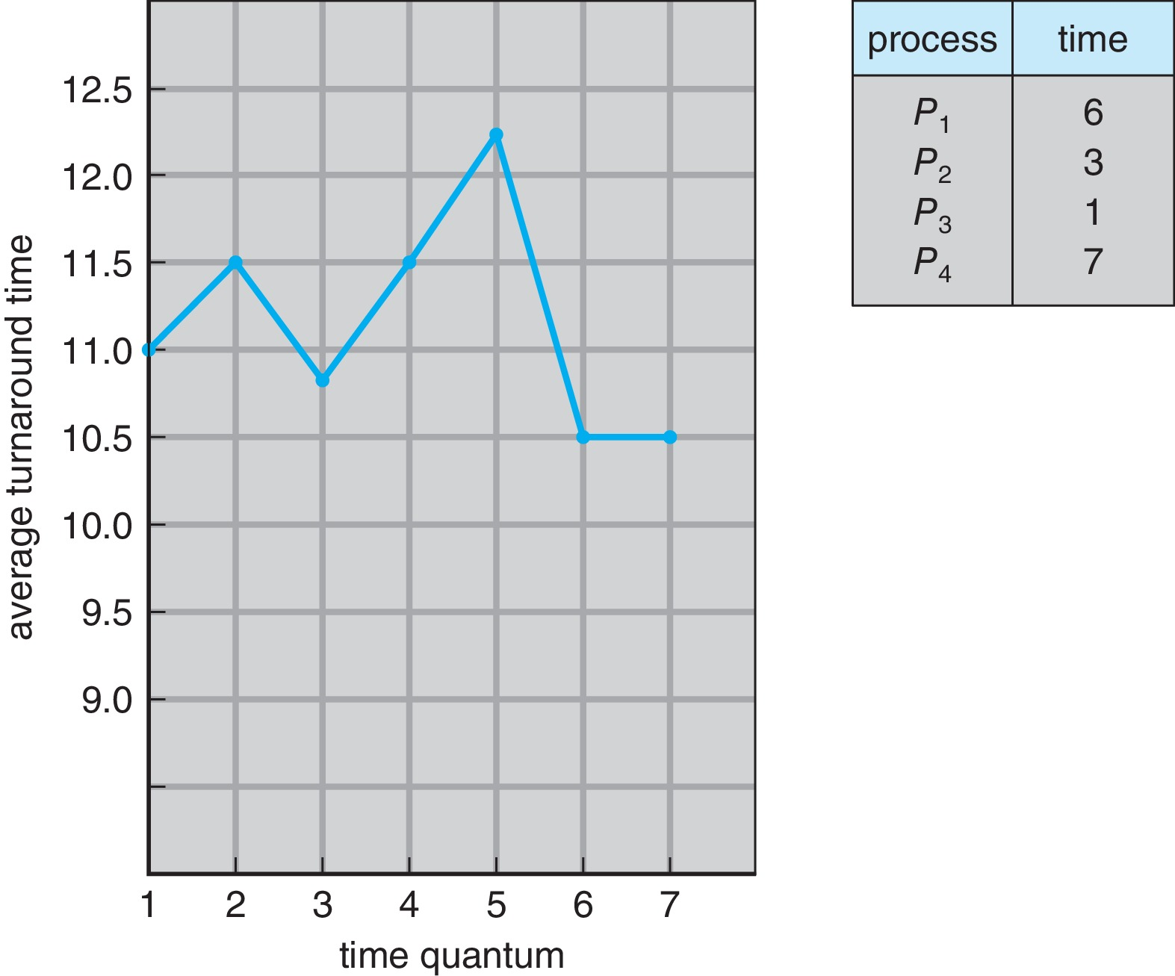
Turnaround Time Varies With The Time Quantum
80% of CPU bursts should be shorter than q

Slide 27
Priority Scheduling
A priority number (integer) is associated with each process
The CPU is allocated to the process with the highest priority (smallest integer ≡ highest priority)
  Preemptive
  Nonpreemptive
SJF is priority scheduling where priority is the inverse of predicted next CPU burst time
Problem ≡ Starvation – low priority processes may never execute
Solution ≡ Aging – as time progresses increase the priority of the process

Slide 28
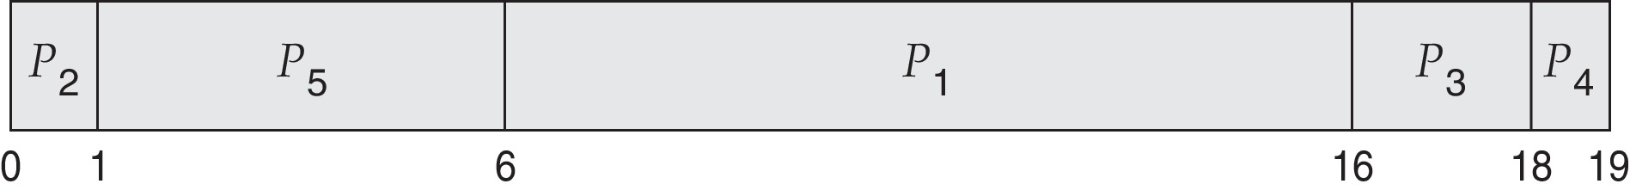
Example of Priority Scheduling
Process Burst Time Priority
P₁ 10 3
P₂ 1 1
P₃ 2 4
P₄ 1 5
P₅ 5 2
Priority scheduling Gantt Chart
Average waiting time = 8.2

Slide 29
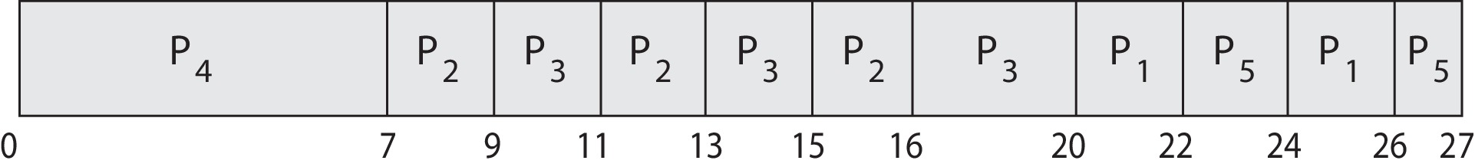
Priority Scheduling w/ Round-Robin
Run the process with the highest priority. Processes with the same priority run round-robin
Example:
Process a Burst Time Priority
P₁ 4 3
P₂ 5 2
P₃ 8 2
P₄ 7 1
P₅ 3 3
Gantt Chart with time quantum = 2

Slide 30
Multilevel Queue
The ready queue consists of multiple queues
Multilevel queue scheduler defined by the following parameters:
  Number of queues
  Scheduling algorithms for each queue
  Method used to determine which queue a process will enter when that process needs service
  Scheduling among the queues

Slide 31
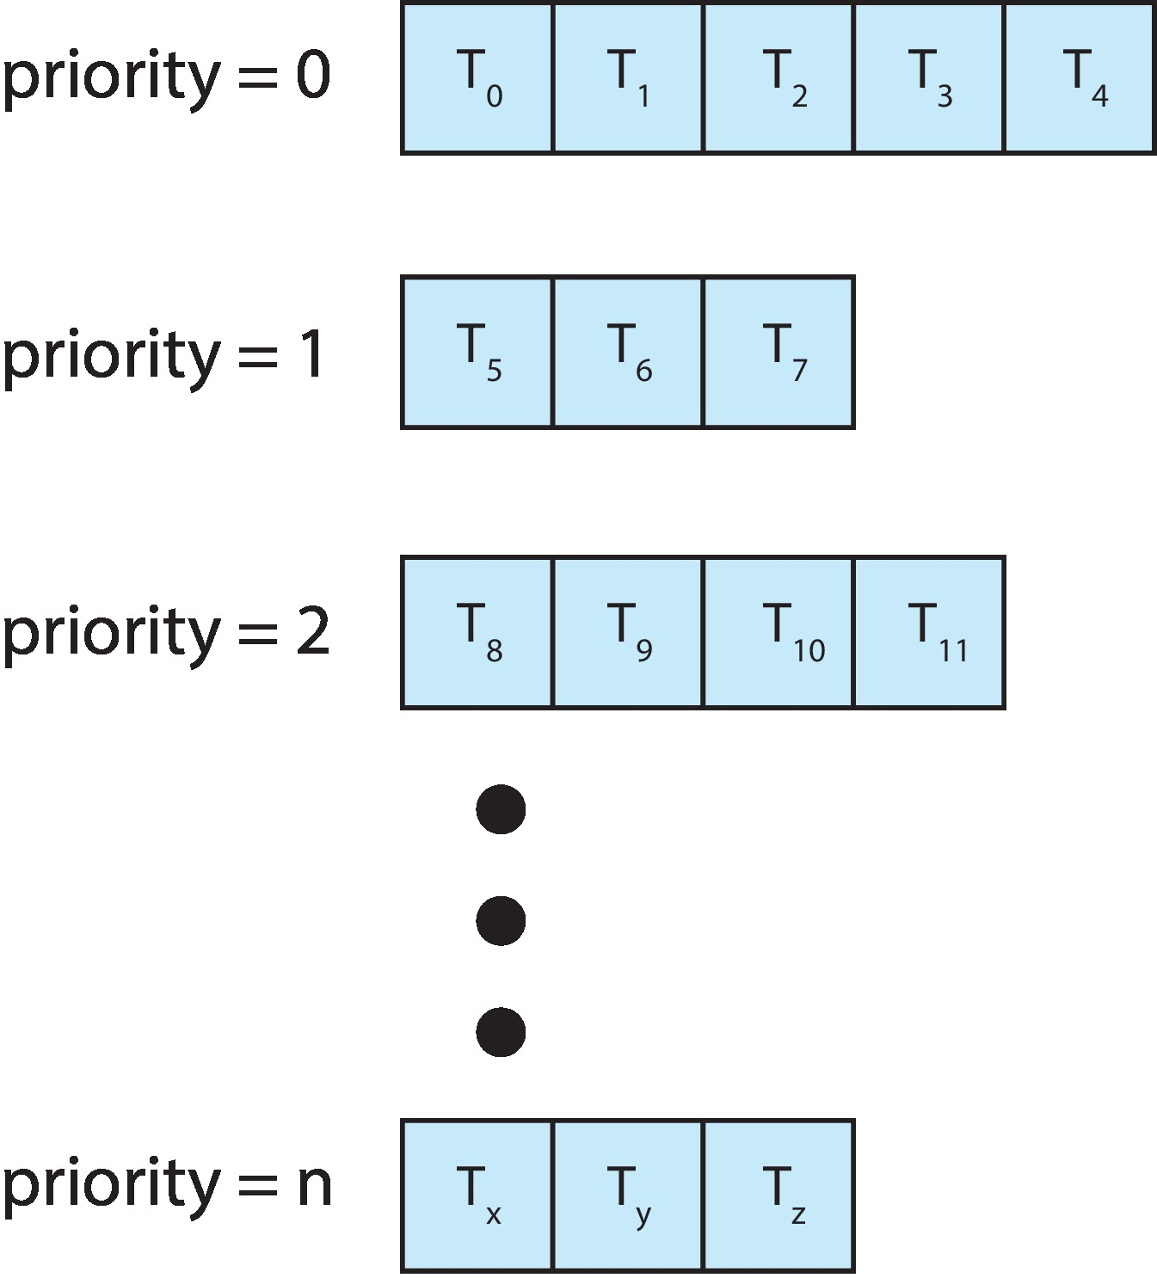
Multilevel Queue
With priority scheduling, have separate queues for each priority.
Schedule the process in the highest-priority queue!

Slide 32
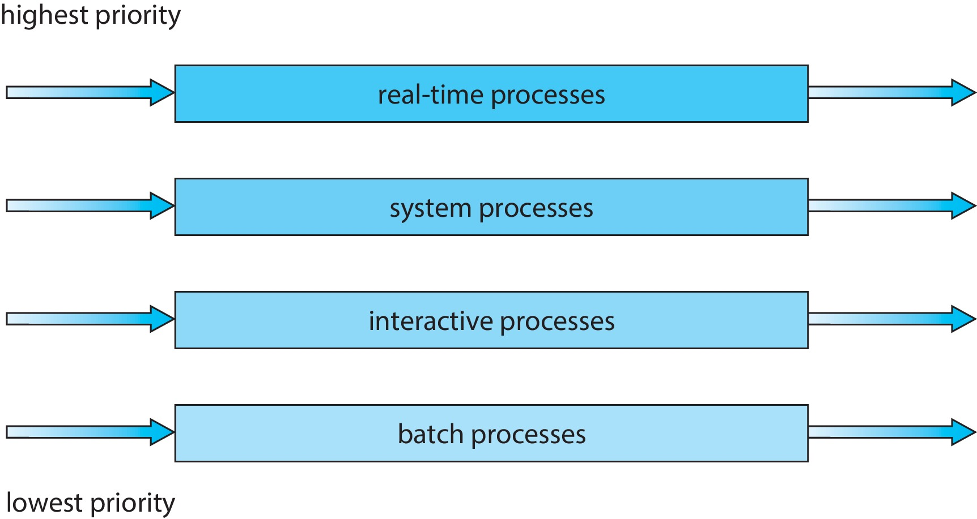
Multilevel Queue
Prioritization based upon process type

Slide 33
Multilevel Feedback Queue
A process can move between the various queues.
Multilevel-feedback-queue scheduler defined by the following parameters:
  Number of queues
  Scheduling algorithms for each queue
  Method used to determine when to upgrade a process
  Method used to determine when to demote a process
  Method used to determine which queue a process will enter when that process needs service
Aging can be implemented using multilevel feedback queue

Slide 34
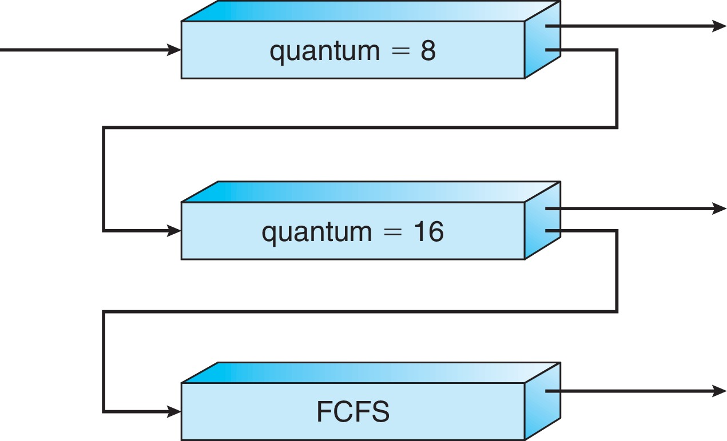
Example of Multilevel Feedback Queue
Three queues:
  Q₀ – RR with time quantum 8 milliseconds
  Q₁ – RR time quantum 16 milliseconds
  Q₂ – FCFS
Scheduling
  A new process enters queue Q₀ which is served in RR
    When it gains CPU, the process receives 8 milliseconds
    If it does not finish in 8 milliseconds, the process is moved to queue Q₁
  At Q₁ job is again served in RR and receives 16 additional milliseconds
    If it still does not complete, it is preempted and moved to queue Q₂

Slide 35
Thread Scheduling
Distinction between user-level and kernel-level threads
When threads supported, threads scheduled, not processes
Many-to-one and many-to-many models, thread library schedules user-level threads to run on LWP
  Known as process-contention scope (PCS) since scheduling competition is within the process
  Typically done via priority set by programmer
Kernel thread scheduled onto available CPU is system-contention scope (SCS) – competition among all threads in system

Slide 36
Pthread Scheduling
API allows specifying either PCS or SCS during thread creation
  PTHREAD_SCOPE_PROCESS schedules threads using PCS scheduling
  PTHREAD_SCOPE_SYSTEM schedules threads using SCS scheduling
Can be limited by OS – Linux and macOS only allow PTHREAD_SCOPE_SYSTEM

Slide 37
Pthread Scheduling API
#include <pthread.h>
#include <stdio.h>
#define NUM_THREADS 5
int main(int argc, char *argv[]) {
int i, scope;
pthread_t tid[NUM THREADS];
pthread_attr_t attr;
/* get the default attributes */
pthread_attr_init(&attr);
/* first inquire on the current scope */
if (pthread_attr_getscope(&attr, &scope) != 0)
fprintf(stderr, "Unable to get scheduling scope\n");
else {
if (scope == PTHREAD_SCOPE_PROCESS)
printf("PTHREAD_SCOPE_PROCESS");
else if (scope == PTHREAD_SCOPE_SYSTEM)
printf("PTHREAD_SCOPE_SYSTEM");
else
fprintf(stderr, "Illegal scope value.\n");
}

Slide 38
Pthread Scheduling API
/* set the scheduling algorithm to PCS or SCS */
pthread_attr_setscope(&attr, PTHREAD_SCOPE_SYSTEM);
/* create the threads */
for (i = 0; i < NUM_THREADS; i++)
pthread_create(&tid[i],&attr,runner,NULL);
/* now join on each thread */
for (i = 0; i < NUM_THREADS; i++)
pthread_join(tid[i], NULL);
}
/* Each thread will begin control in this function */
void *runner(void *param)
{
/* do some work ... */
pthread_exit(0);
}

Slide 39
Multiple-Processor Scheduling
CPU scheduling more complex when multiple CPUs are available
Multiprocess may be any one of the following architectures:
  Multicore CPUs
  Multithreaded cores
  NUMA systems
  Heterogeneous multiprocessing

Slide 40
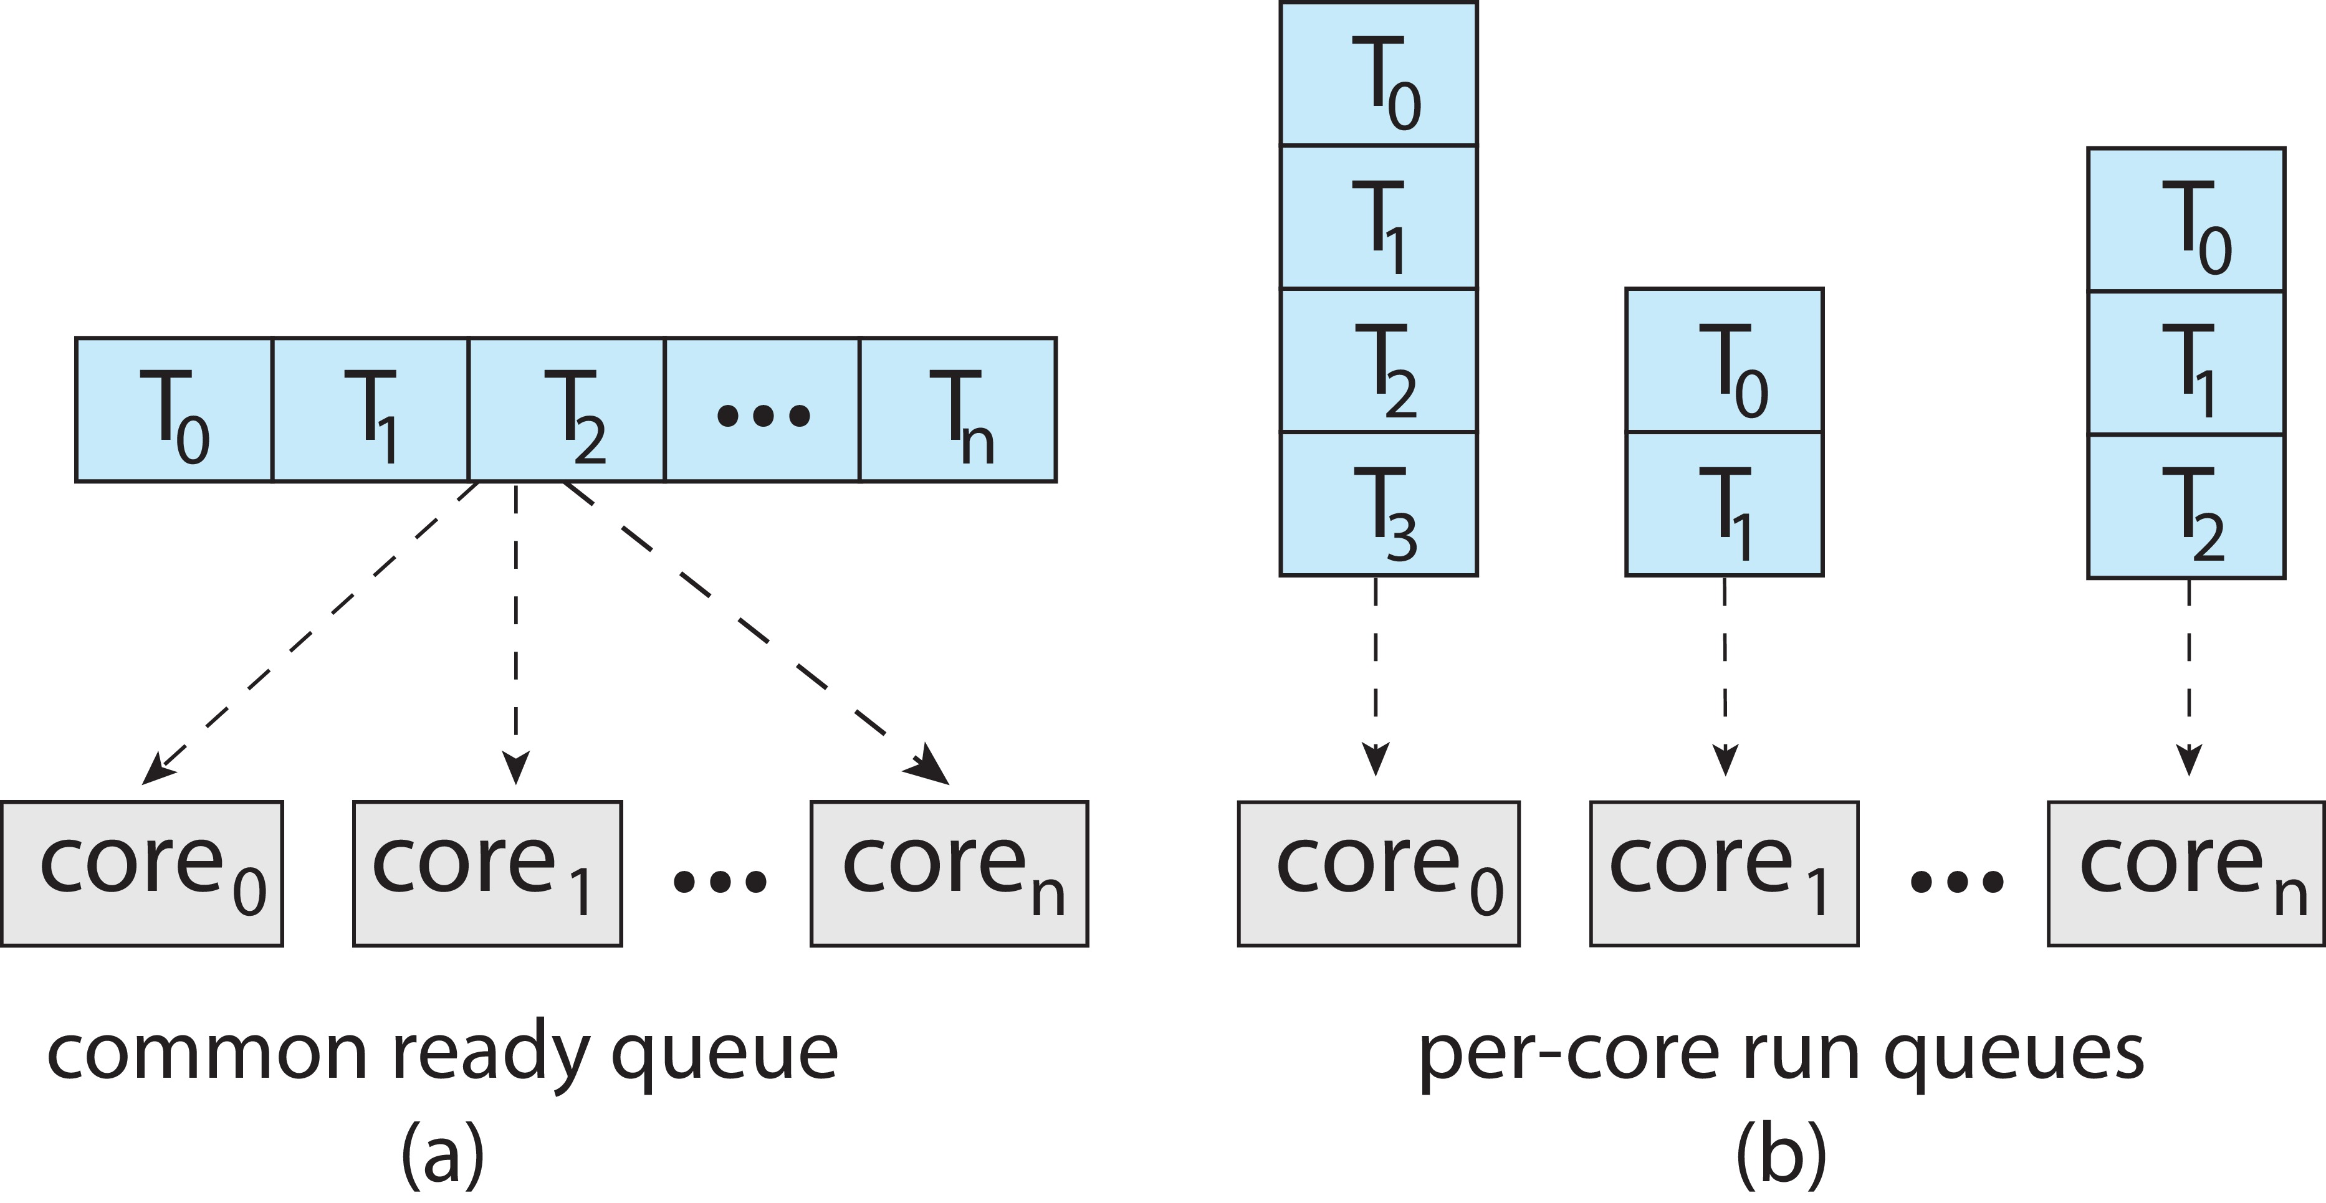
Multiple-Processor Scheduling
Symmetric multiprocessing (SMP) is where each processor is self scheduling.
All threads may be in a common ready queue (a)
Each processor may have its own private queue of threads (b)

Slide 41
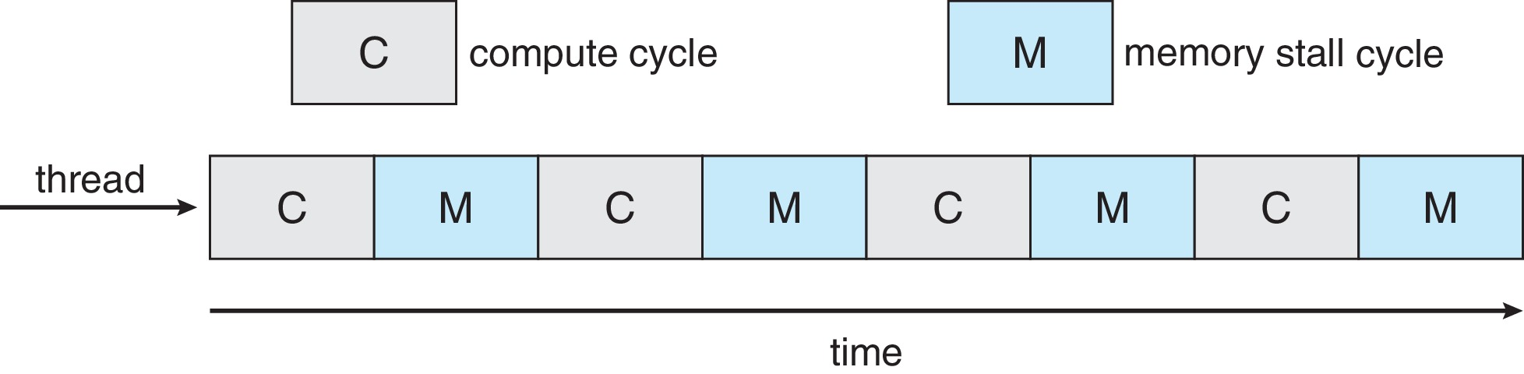
Multicore Processors
Recent trend to place multiple processor cores on same physical chip
Faster and consumes less power
Multiple threads per core also growing
  Takes advantage of memory stall to make progress on another thread while memory retrieve happens
Figure

Slide 42
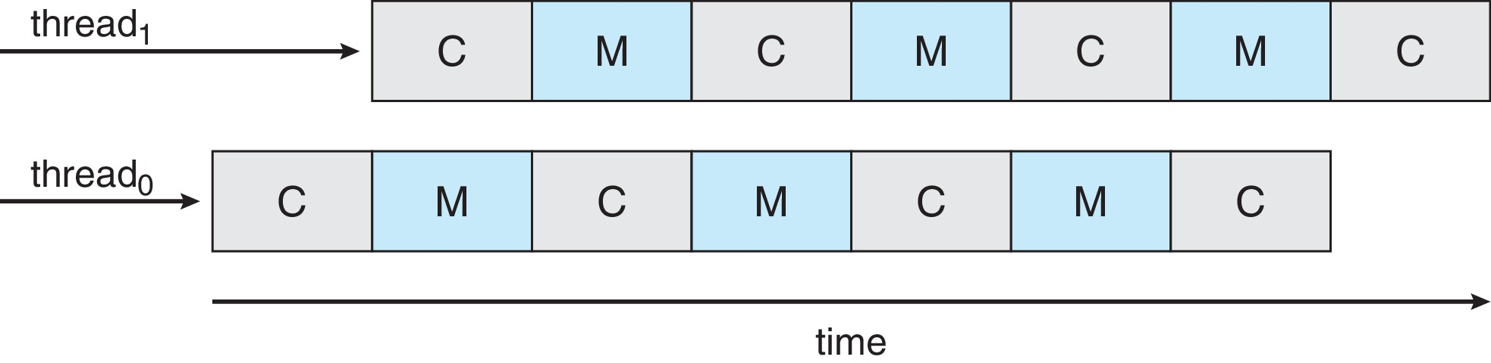
Multithreaded Multicore System
Each core has > 1 hardware threads.
If one thread has a memory stall, switch to another thread!
Figure

Slide 43
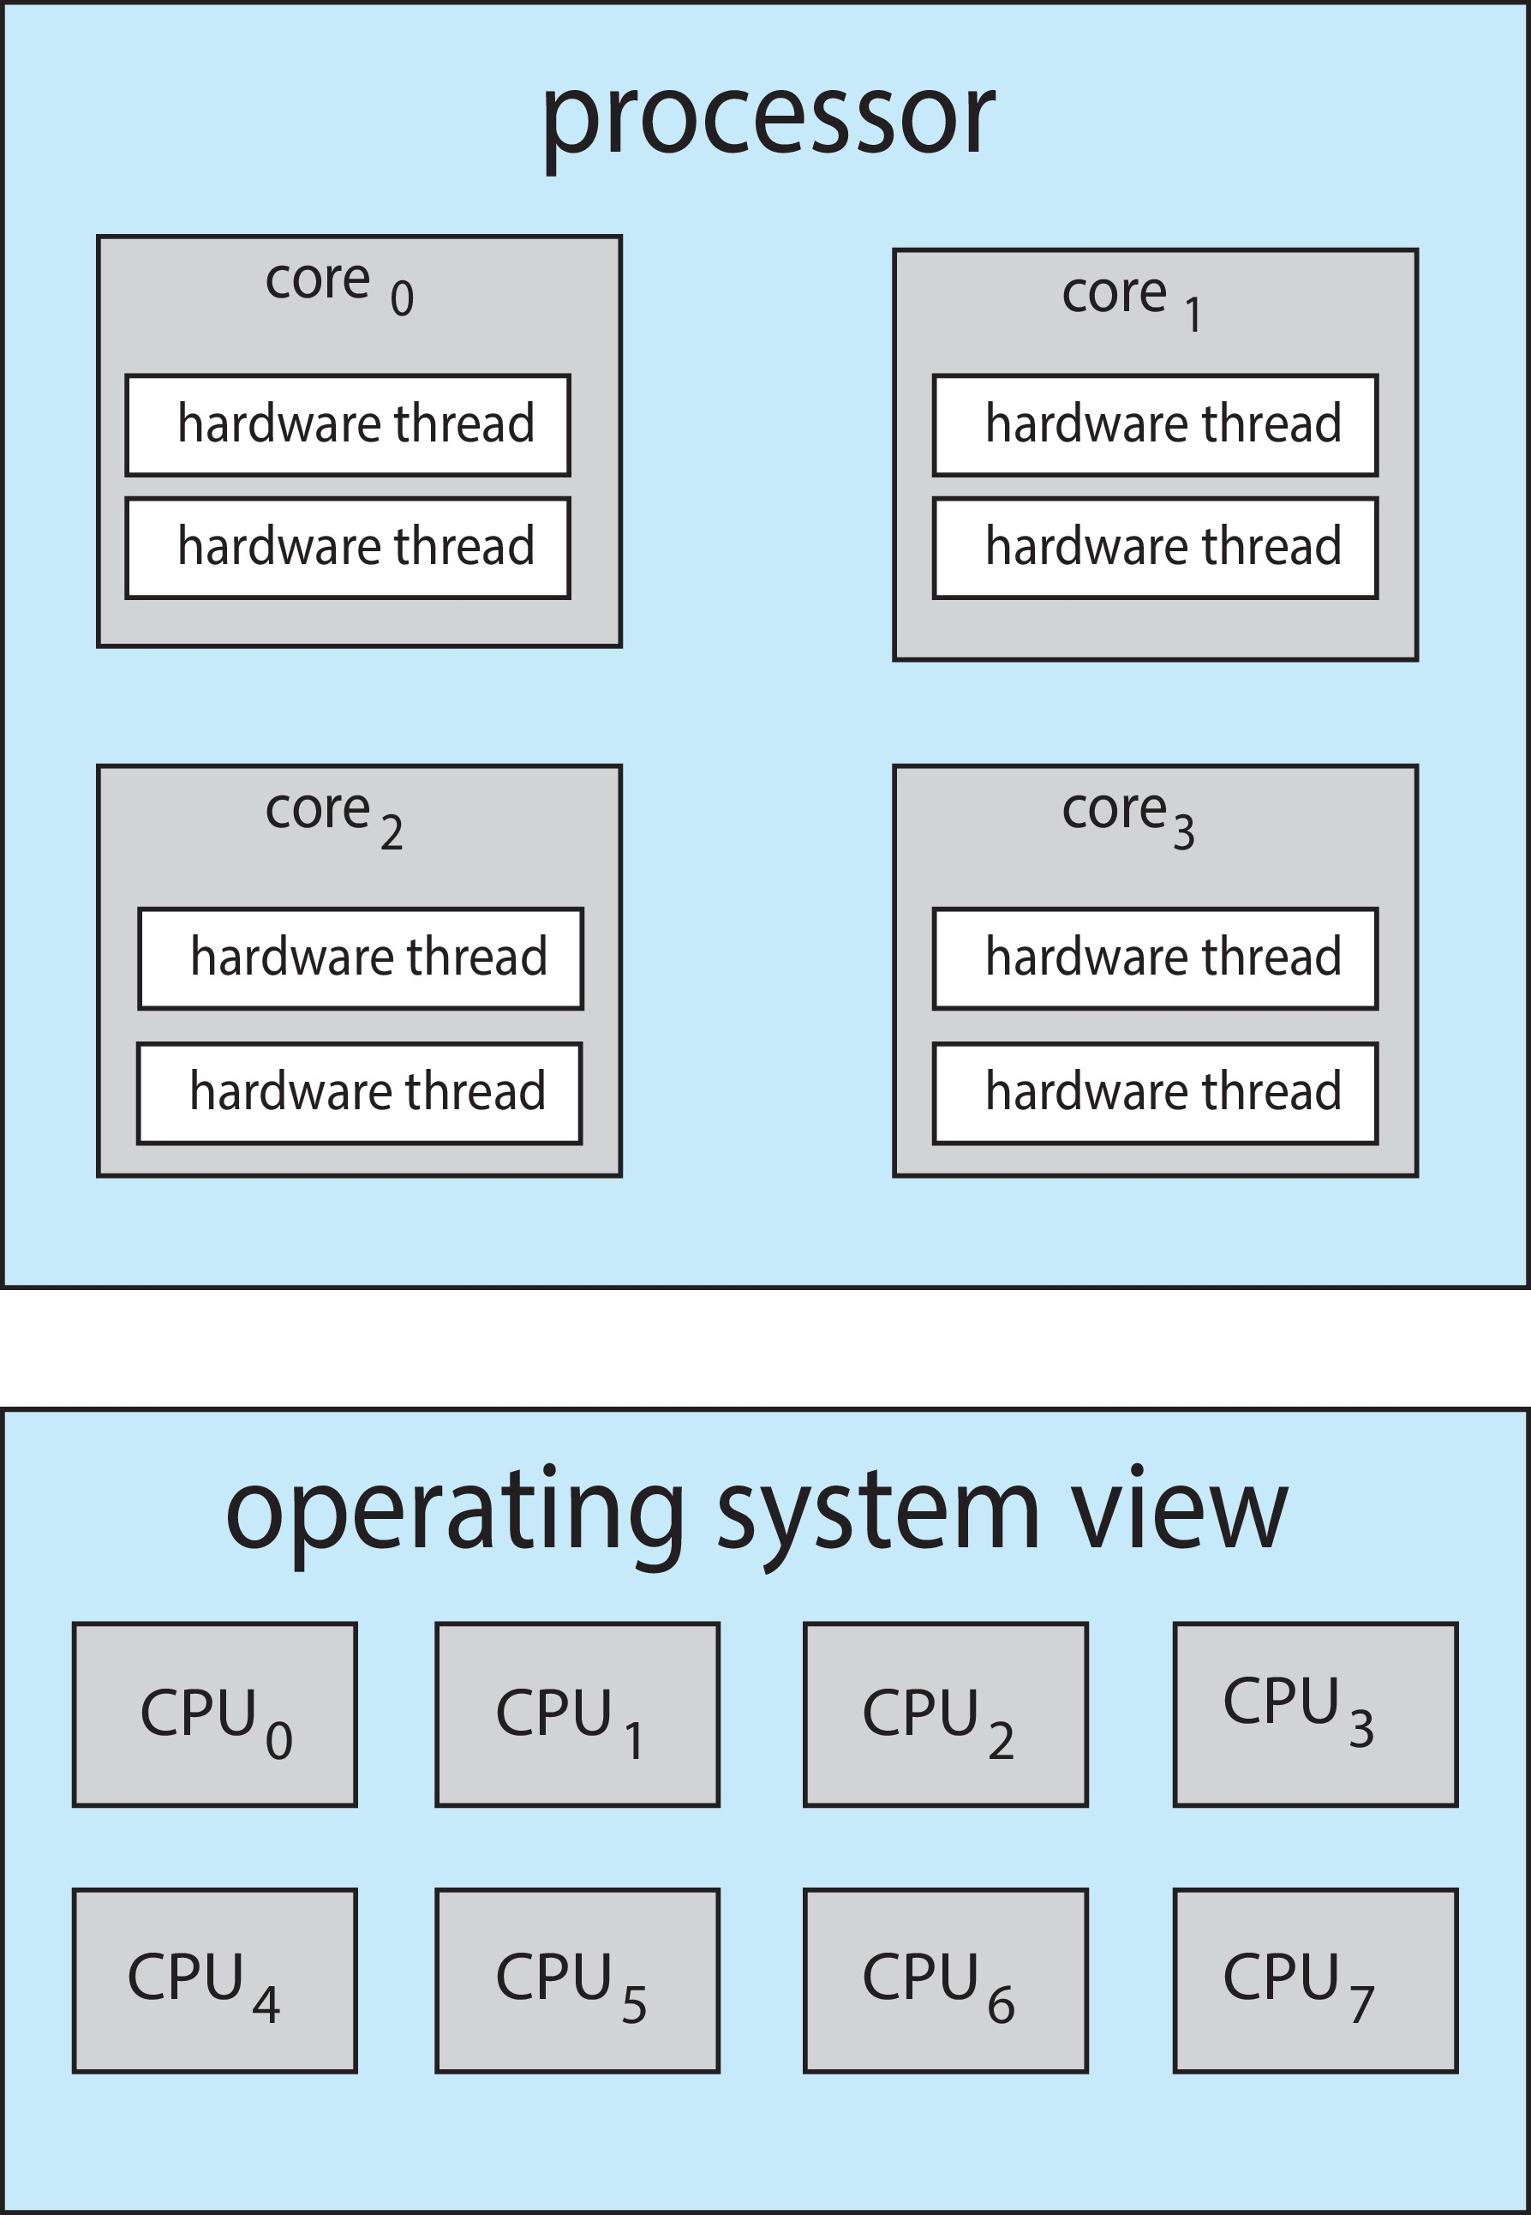
Multithreaded Multicore System
Chip-multithreading (CMT) assigns each core multiple hardware threads. (Intel refers to this as hyperthreading.)
On a quad-core system with 2 hardware threads per core, the operating system sees 8 logical processors.

Slide 44
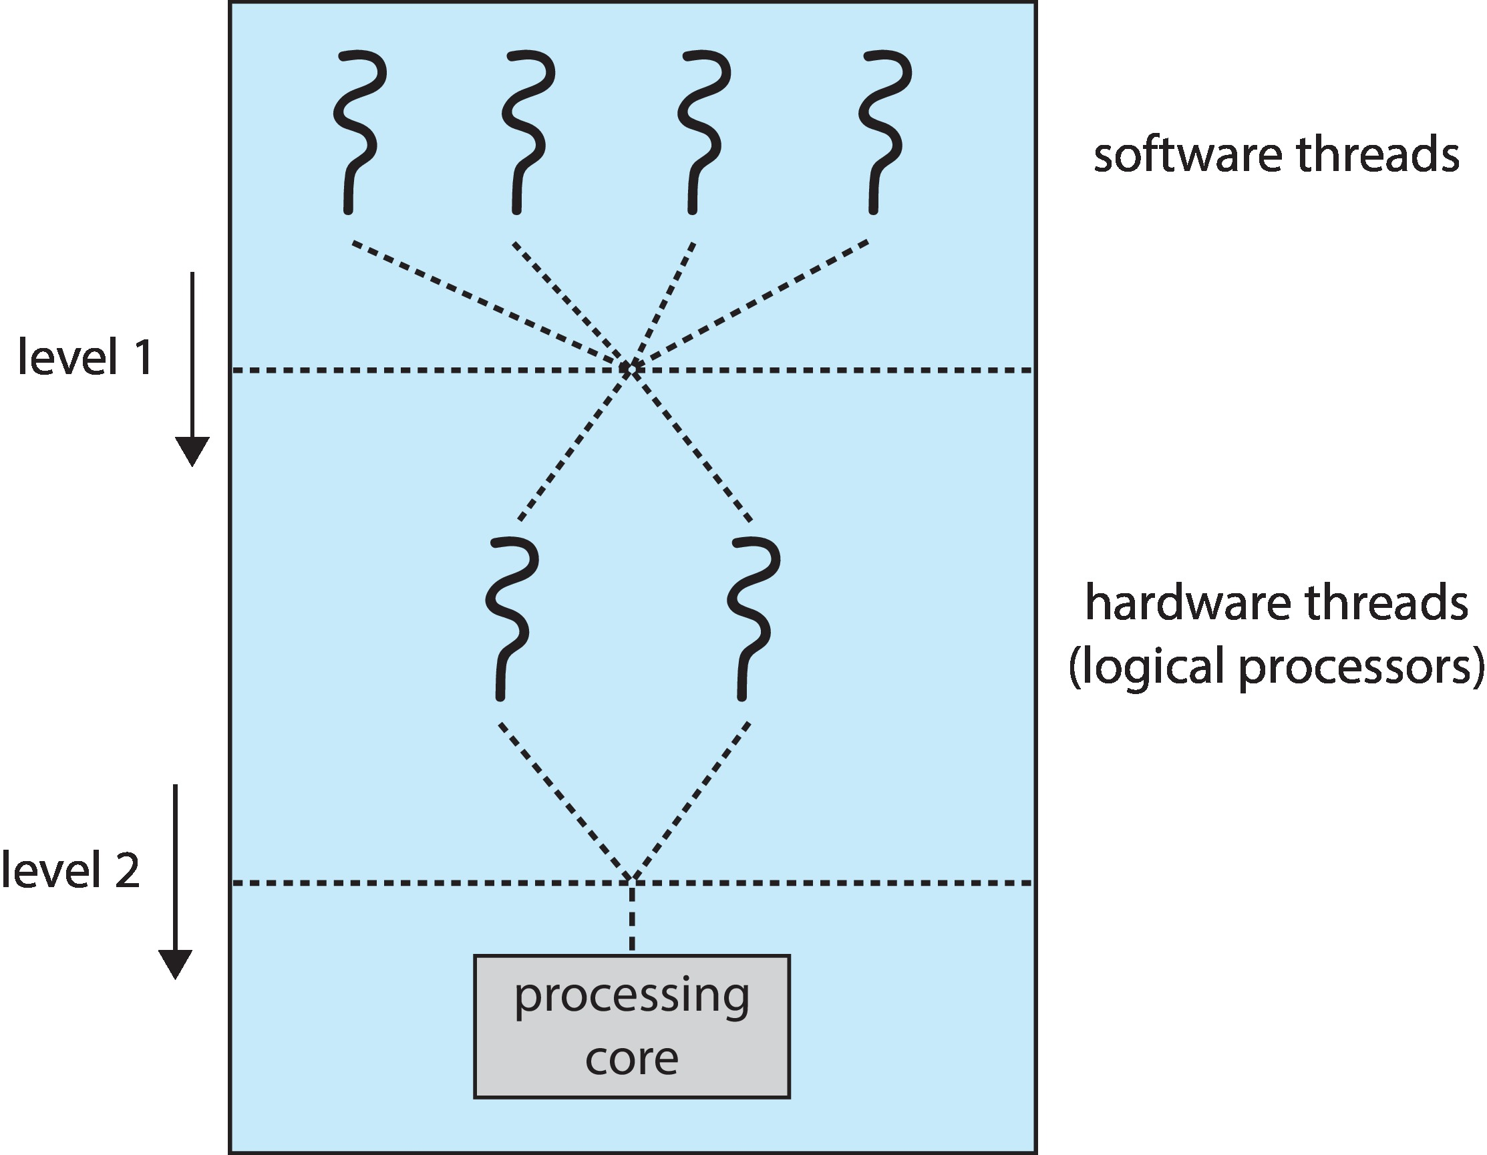
Multithreaded Multicore System
Two levels of scheduling:
  The operating system deciding which software thread to run on a logical CPU
  How each core decides which hardware thread to run on the physical core.

Slide 45
Multiple-Processor Scheduling – Load Balancing
If SMP, need to keep all CPUs loaded for efficiency
Load balancing attempts to keep workload evenly distributed
Push migration – periodic task checks load on each processor, and if found pushes task from overloaded CPU to other CPUs
Pull migration – idle processors pulls waiting task from busy processor

Slide 46
Multiple-Processor Scheduling – Processor Affinity
When a thread has been running on one processor, the cache contents of that processor stores the memory accesses by that thread.
We refer to this as a thread having affinity for a processor (i.e., “processor affinity”)
Load balancing may affect processor affinity as a thread may be moved from one processor to another to balance loads, yet that thread loses the contents of what it had in the cache of the processor it was moved off of.
Soft affinity – the operating system attempts to keep a thread running on the same processor, but no guarantees.
Hard affinity – allows a process to specify a set of processors it may run on.

Slide 47
NUMA and CPU Scheduling
If the operating system is NUMA-aware, it will assign memory closes to the CPU the thread is running on.

Slide 48
Real-Time CPU Scheduling
Can present obvious challenges
Soft real-time systems – Critical real-time tasks have the highest priority, but no guarantee as to when tasks will be scheduled
Hard real-time systems – task must be serviced by its deadline

Slide 49
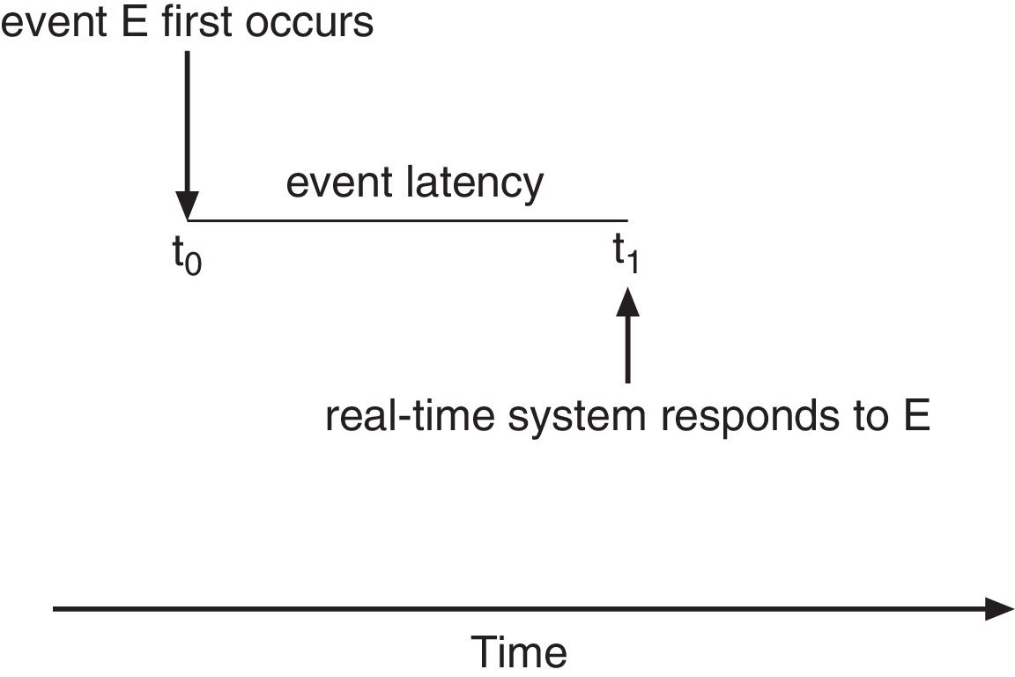
Real-Time CPU Scheduling
Event latency – the amount of time that elapses from when an event occurs to when it is serviced.
Two types of latencies affect performance
  Interrupt latency – time from arrival of interrupt to start of routine that services interrupt
  Dispatch latency – time for schedule to take current process off CPU and switch to another

Slide 50
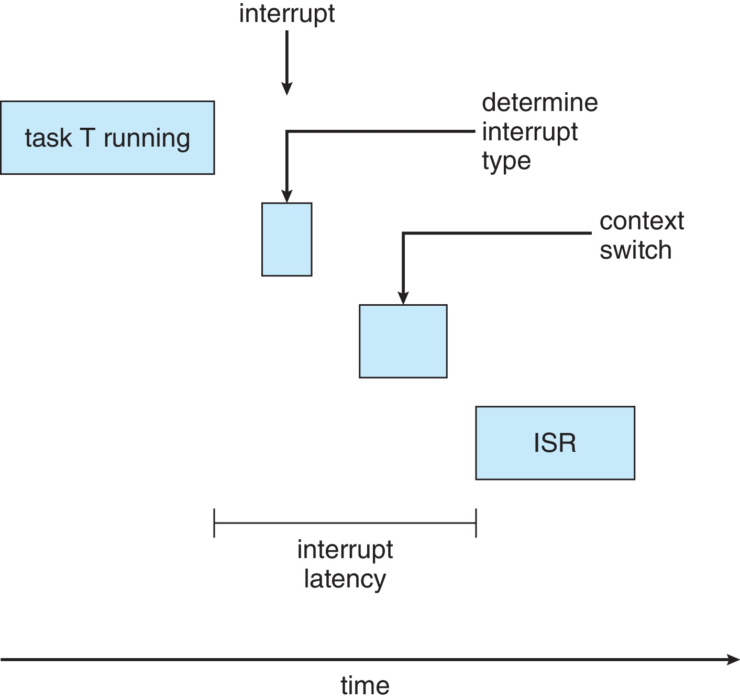
Interrupt Latency

Slide 51
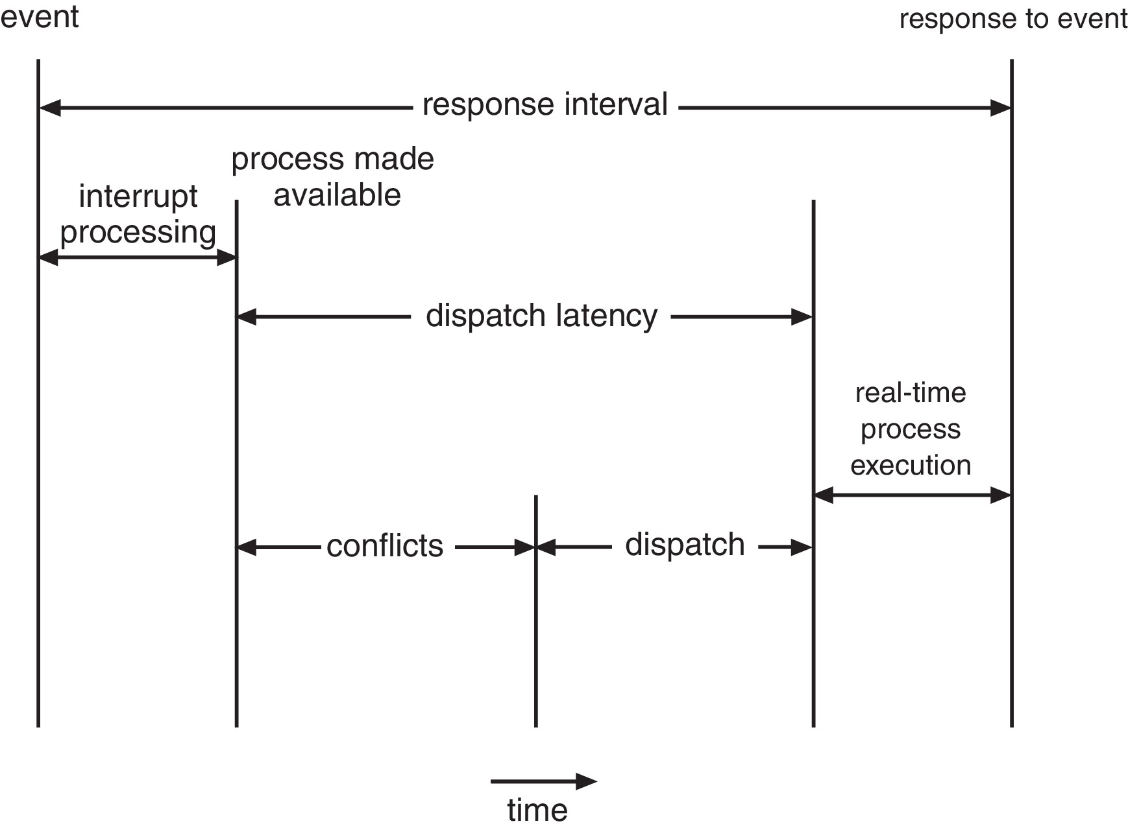
Dispatch Latency
Conflict phase of dispatch latency:
  Preemption of any process running in kernel mode
  Release by low-priority process of resources needed by high-priority processes

Slide 52
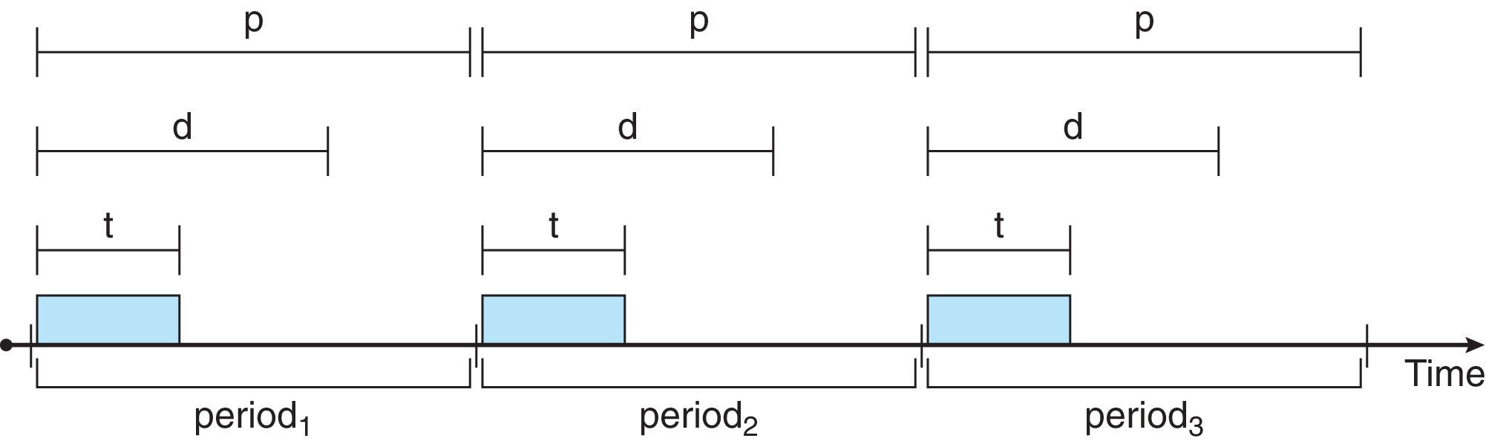
Priority-based Scheduling
For real-time scheduling, scheduler must support preemptive, priority-based scheduling
  But only guarantees soft real-time
For hard real-time must also provide ability to meet deadlines
Processes have new characteristics: periodic ones require CPU at constant intervals
  Has processing time t, deadline d, period p
  0 ≤ t ≤ d ≤ p
  Rate of periodic task is 1/p

Slide 53
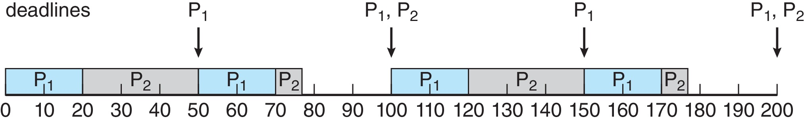
Rate Monotonic Scheduling
A priority is assigned based on the inverse of its period
Shorter periods = higher priority;
Longer periods = lower priority
P₁ is assigned a higher priority than P₂.

Slide 54
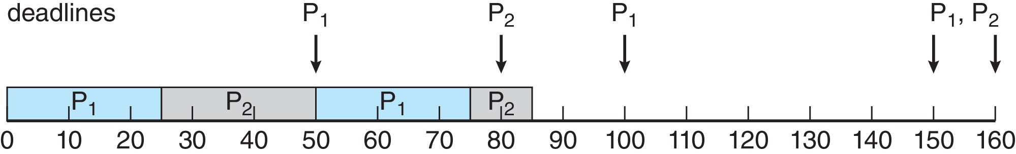
Missed Deadlines with Rate Monotonic Scheduling
Process P₂ misses finishing its deadline at time 80
Figure

Slide 55
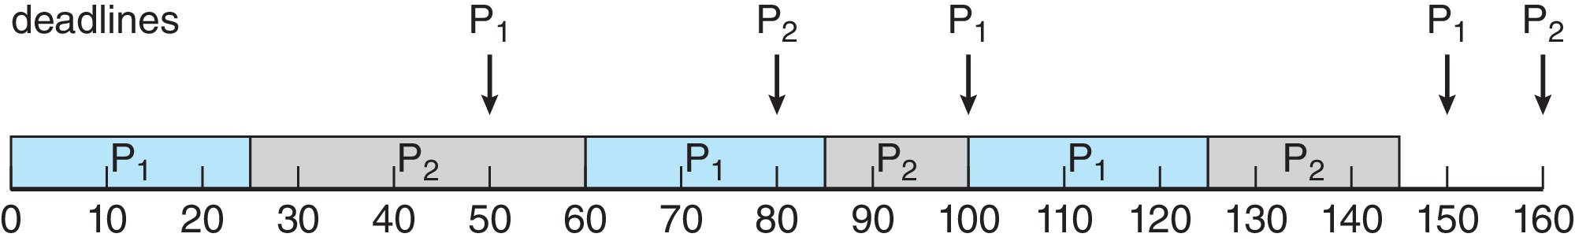
Earliest Deadline First Scheduling (EDF)
Priorities are assigned according to deadlines:
  The earlier the deadline, the higher the priority
  The later the deadline, the lower the priority
Figure

Slide 56
Proportional Share Scheduling
T shares are allocated among all processes in the system
An application receives N shares where N < T
This ensures each application will receive N / T of the total processor time

Slide 57
POSIX Real-Time Scheduling
The POSIX.1b standard
API provides functions for managing real-time threads
Defines two scheduling classes for real-time threads:
  SCHED_FIFO - threads are scheduled using a FCFS strategy with a FIFO queue. There is no time-slicing for threads of equal priority
  SCHED_RR - similar to SCHED_FIFO except time-slicing occurs for threads of equal priority
Defines two functions for getting and setting scheduling policy:
  pthread_attr_getsched_policy(pthread_attr_t *attr, int *policy)
  pthread_attr_setsched_policy(pthread_attr_t *attr, int policy)

Slide 58
POSIX Real-Time Scheduling API
#include <pthread.h>
#include <stdio.h>
#define NUM_THREADS 5
int main(int argc, char *argv[])
{
int i, policy;
pthread_t_tid[NUM_THREADS];
pthread_attr_t attr;
/* get the default attributes */
pthread_attr_init(&attr);
/* get the current scheduling policy */
if (pthread_attr_getschedpolicy(&attr, &policy) != 0)
fprintf(stderr, "Unable to get policy.\n");
else {
if (policy == SCHED_OTHER) printf("SCHED_OTHER\n");
else if (policy == SCHED_RR) printf("SCHED_RR\n");
else if (policy == SCHED_FIFO) printf("SCHED_FIFO\n");
}

Slide 59
POSIX Real-Time Scheduling API (Cont.)
/* set the scheduling policy - FIFO, RR, or OTHER */
if (pthread_attr_setschedpolicy(&attr, SCHED_FIFO) != 0)
fprintf(stderr, "Unable to set policy.\n");
/* create the threads */
for (i = 0; i < NUM_THREADS; i++)
pthread_create(&tid[i],&attr,runner,NULL);
/* now join on each thread */
for (i = 0; i < NUM_THREADS; i++)
pthread_join(tid[i], NULL);
}
/* Each thread will begin control in this function */
void *runner(void *param)
{
/* do some work ... */
pthread_exit(0);
}

Slide 60
Operating System Examples
Linux scheduling
Windows scheduling
Solaris scheduling

Slide 61
Linux Scheduling Through Version 2.5
Prior to kernel version 2.5, ran variation of standard UNIX scheduling algorithm
Version 2.5 moved to constant order O(1) scheduling time
  Preemptive, priority based
  Two priority ranges: time-sharing and real-time
  Real-time range from 0 to 99 and nice value from 100 to 140
  Map into global priority with numerically lower values indicating higher priority
  Higher priority gets larger q
  Task run-able as long as time left in time slice (active)
  If no time left (expired), not run-able until all other tasks use their slices
  All run-able tasks tracked in per-CPU runqueue data structure
    Two priority arrays (active, expired)
    Tasks indexed by priority
    When no more active, arrays are exchanged
  Worked well, but poor response times for interactive processes

Slide 62
Linux Scheduling in Version 2.6.23 +
Completely Fair Scheduler (CFS)
Scheduling classes
  Each has specific priority
  Scheduler picks highest priority task in highest scheduling class
  Rather than quantum based on fixed time allotments, based on proportion of CPU time
  Two scheduling classes included, others can be added
    default
    real-time

Slide 63
Linux Scheduling in Version 2.6.23 + (Cont.)
Quantum calculated based on nice value from -20 to +19
  Lower value is higher priority
  Calculates target latency – interval of time during which task should run at least once
  Target latency can increase if say number of active tasks increases
CFS scheduler maintains per task virtual run time in variable vruntime
  Associated with decay factor based on priority of task – lower priority is higher decay rate
  Normal default priority yields virtual run time = actual run time
To decide next task to run, scheduler picks task with lowest virtual run time

Slide 64
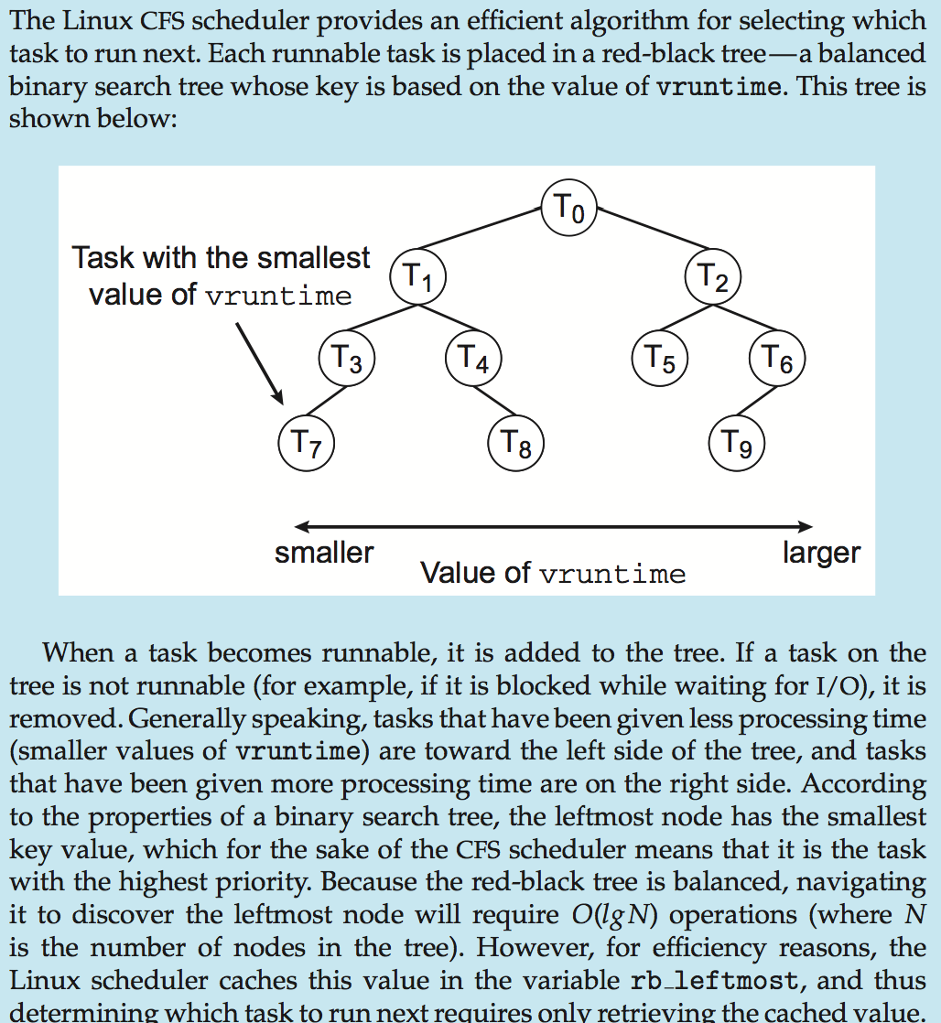
CFS Performance

Slide 65
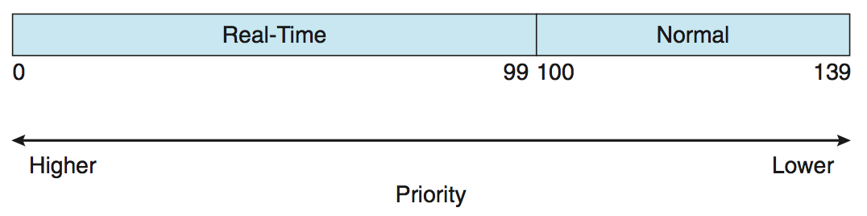
Linux Scheduling (Cont.)
Real-time scheduling according to POSIX.1b
  Real-time tasks have static priorities
Real-time plus normal map into global priority scheme
Nice value of -20 maps to global priority 100
Nice value of +19 maps to priority 139

Slide 66
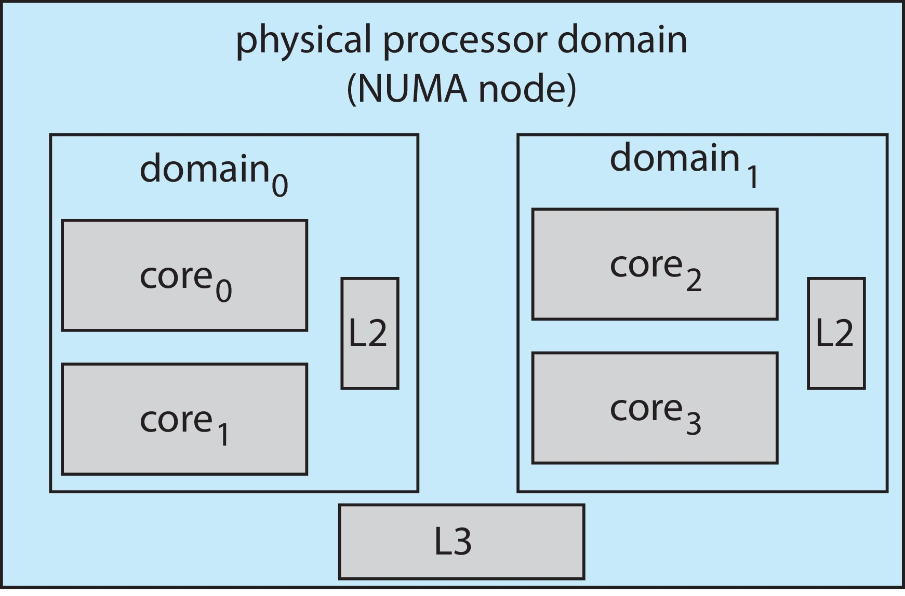
Linux Scheduling (Cont.)
Linux supports load balancing, but is also NUMA-aware.
Scheduling domain is a set of CPU cores that can be balanced against one another.
Domains are organized by what they share (i.e., cache memory.) Goal is to keep threads from migrating between domains.

Slide 67
Windows Scheduling
Windows uses priority-based preemptive scheduling
Highest-priority thread runs next
Dispatcher is scheduler
Thread runs until (1) blocks, (2) uses time slice, (3) preempted by higher-priority thread
Real-time threads can preempt non-real-time
32-level priority scheme
Variable class is 1-15, real-time class is 16-31
Priority 0 is memory-management thread
Queue for each priority
If no run-able thread, runs idle thread

Slide 68
Windows Priority Classes
Win32 API identifies several priority classes to which a process can belong
  REALTIME_PRIORITY_CLASS, HIGH_PRIORITY_CLASS, ABOVE_NORMAL_PRIORITY_CLASS,NORMAL_PRIORITY_CLASS, BELOW_NORMAL_PRIORITY_CLASS, IDLE_PRIORITY_CLASS
  All are variable except REALTIME
A thread within a given priority class has a relative priority
  TIME_CRITICAL, HIGHEST, ABOVE_NORMAL, NORMAL, BELOW_NORMAL, LOWEST, IDLE
Priority class and relative priority combine to give numeric priority
Base priority is NORMAL within the class
If quantum expires, priority lowered, but never below base

Slide 69
Windows Priority Classes (Cont.)
If wait occurs, priority boosted depending on what was waited for
Foreground window given 3x priority boost
Windows 7 added user-mode scheduling (UMS)
  Applications create and manage threads independent of kernel
  For large number of threads, much more efficient
  UMS schedulers come from programming language libraries like C++ Concurrent Runtime (ConcRT) framework

Slide 70
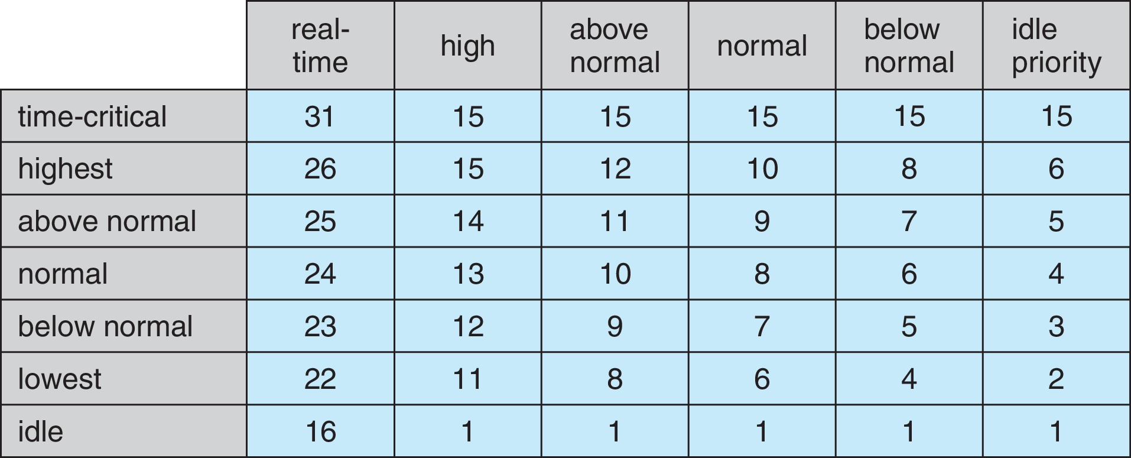
Windows Priorities

Slide 71
Solaris
Priority-based scheduling
Six classes available
  Time sharing (default) (TS)
  Interactive (IA)
  Real time (RT)
  System (SYS)
  Fair Share (FSS)
  Fixed priority (FP)
Given thread can be in one class at a time
Each class has its own scheduling algorithm
Time sharing is multi-level feedback queue
  Loadable table configurable by sysadmin

Slide 72
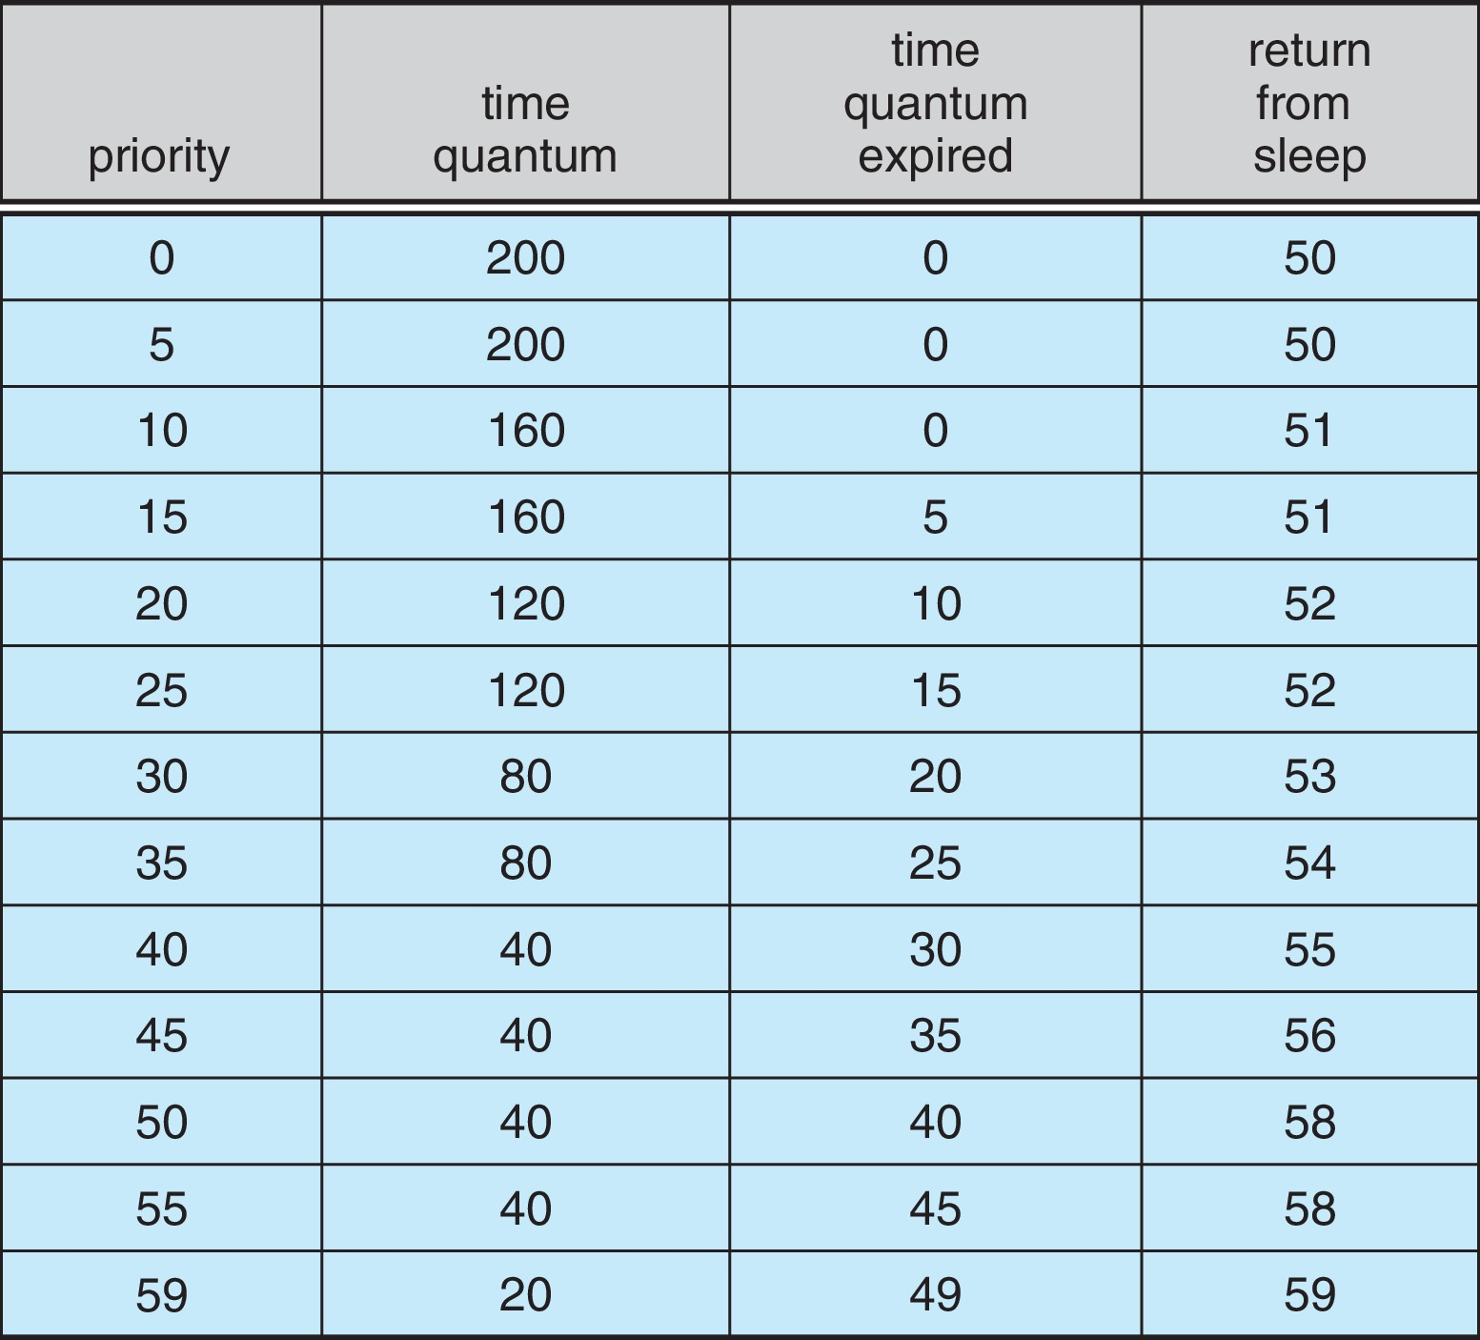
Solaris Dispatch Table

Slide 73
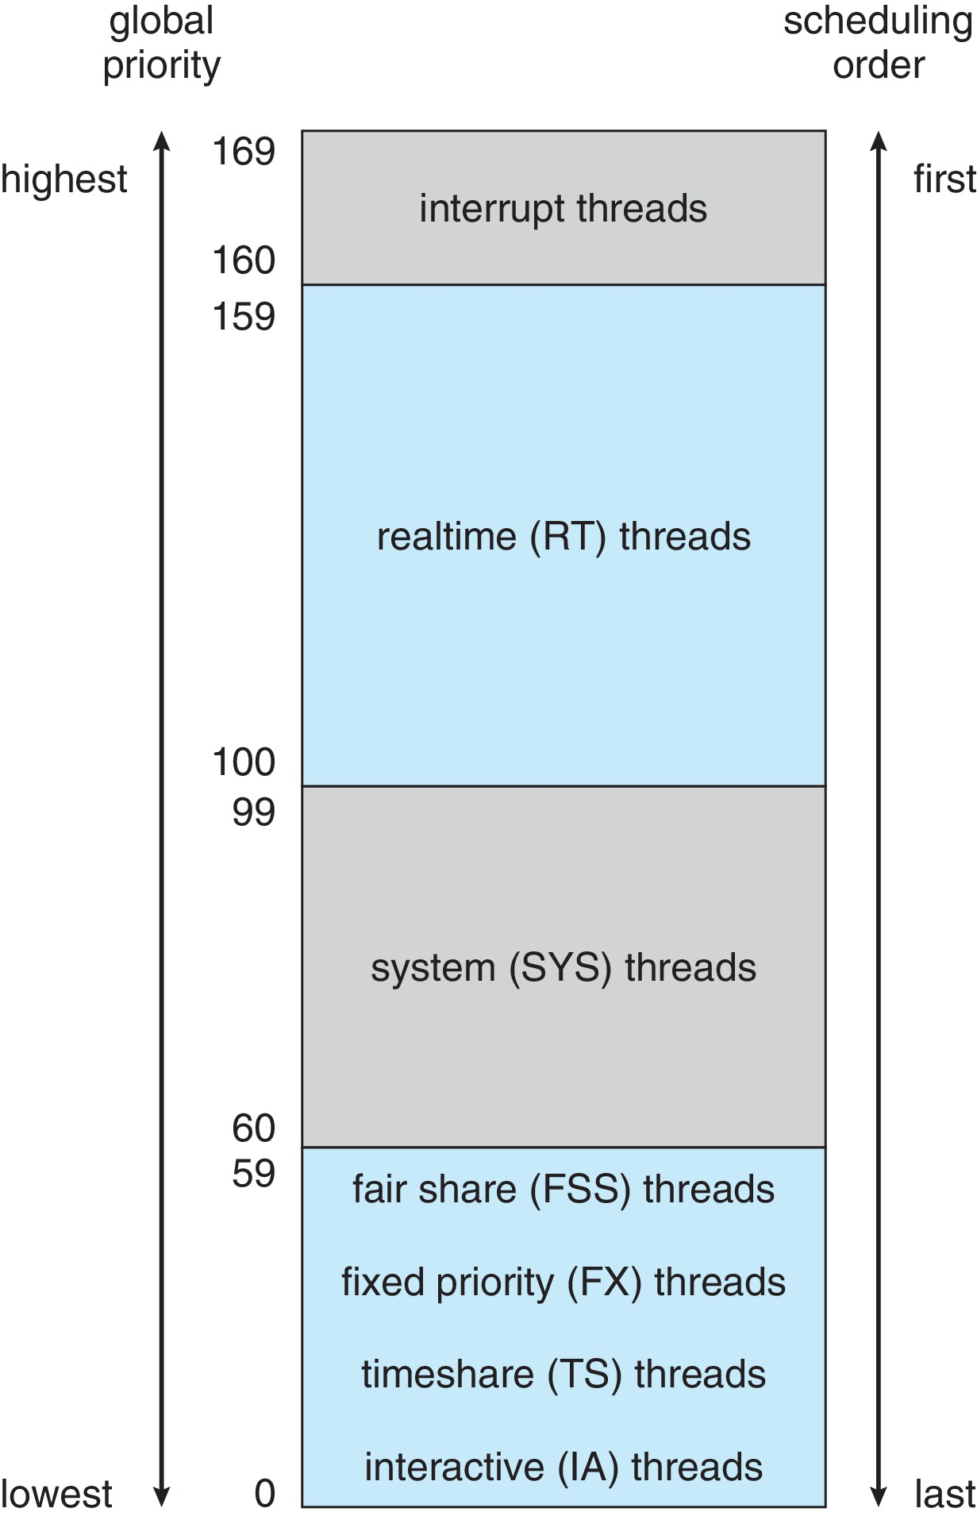
Solaris Scheduling

Slide 74
Solaris Scheduling (Cont.)
Scheduler converts class-specific priorities into a per-thread global priority
  Thread with highest priority runs next
  Runs until (1) blocks, (2) uses time slice, (3) preempted by higher-priority thread
  Multiple threads at same priority selected via RR

Slide 75
Algorithm Evaluation
Deterministic modeling
Queuing Model
Simulatiom

Slide 76
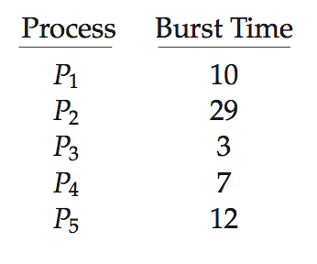
Deterministic modeling
How to select CPU-scheduling algorithm for an OS?
Determine criteria, then evaluate algorithms
  Type of analytic evaluation
  Takes a particular predetermined workload and defines the performance of each algorithm for that workload
Consider 5 processes arriving at time 0:

Slide 77
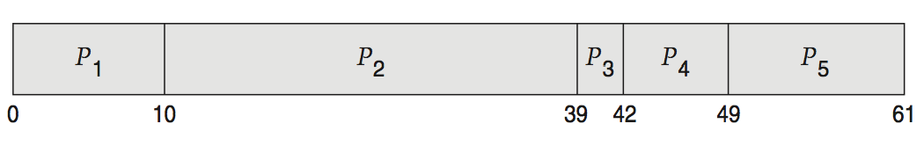
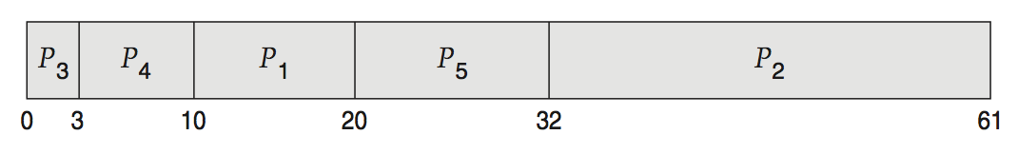
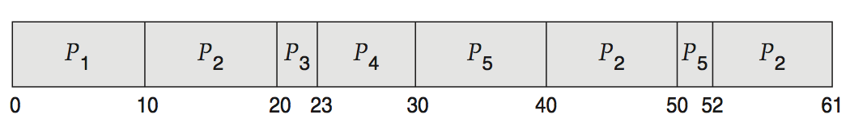
Deterministic Evaluation
For each algorithm, calculate minimum average waiting time
Simple and fast, but requires exact numbers for input, applies only to those inputs
  FCS is 28ms:
  Non-preemptive SFJ is 13ms:
  RR is 23ms:

Slide 78
Queueing Models
Describes the arrival of processes, and CPU and I/O bursts probabilistically
  Commonly exponential, and described by mean
  Computes average throughput, utilization, waiting time, etc.
Computer system described as network of servers, each with queue of waiting processes
  Knowing arrival rates and service rates
  Computes utilization, average queue length, average wait time, etc.

Slide 79
Little’s Formula
n = average queue length
W = average waiting time in queue
λ = average arrival rate into queue
Little’s law – in steady state, processes leaving queue must equal processes arriving, thus:
n = λ x W
  Valid for any scheduling algorithm and arrival distribution
For example, if on average 7 (λ)processes arrive per second, and normally 14 (n)processes in queue, then average wait time per process (W)= 2 seconds

Slide 80
Simulations
Queueing models limited
Simulations more accurate
  Programmed model of computer system
  Clock is a variable
  Gather statistics indicating algorithm performance
  Data to drive simulation gathered via
    Random number generator according to probabilities
    Distributions defined mathematically or empirically
    Trace tapes record sequences of real events in real systems

Slide 81
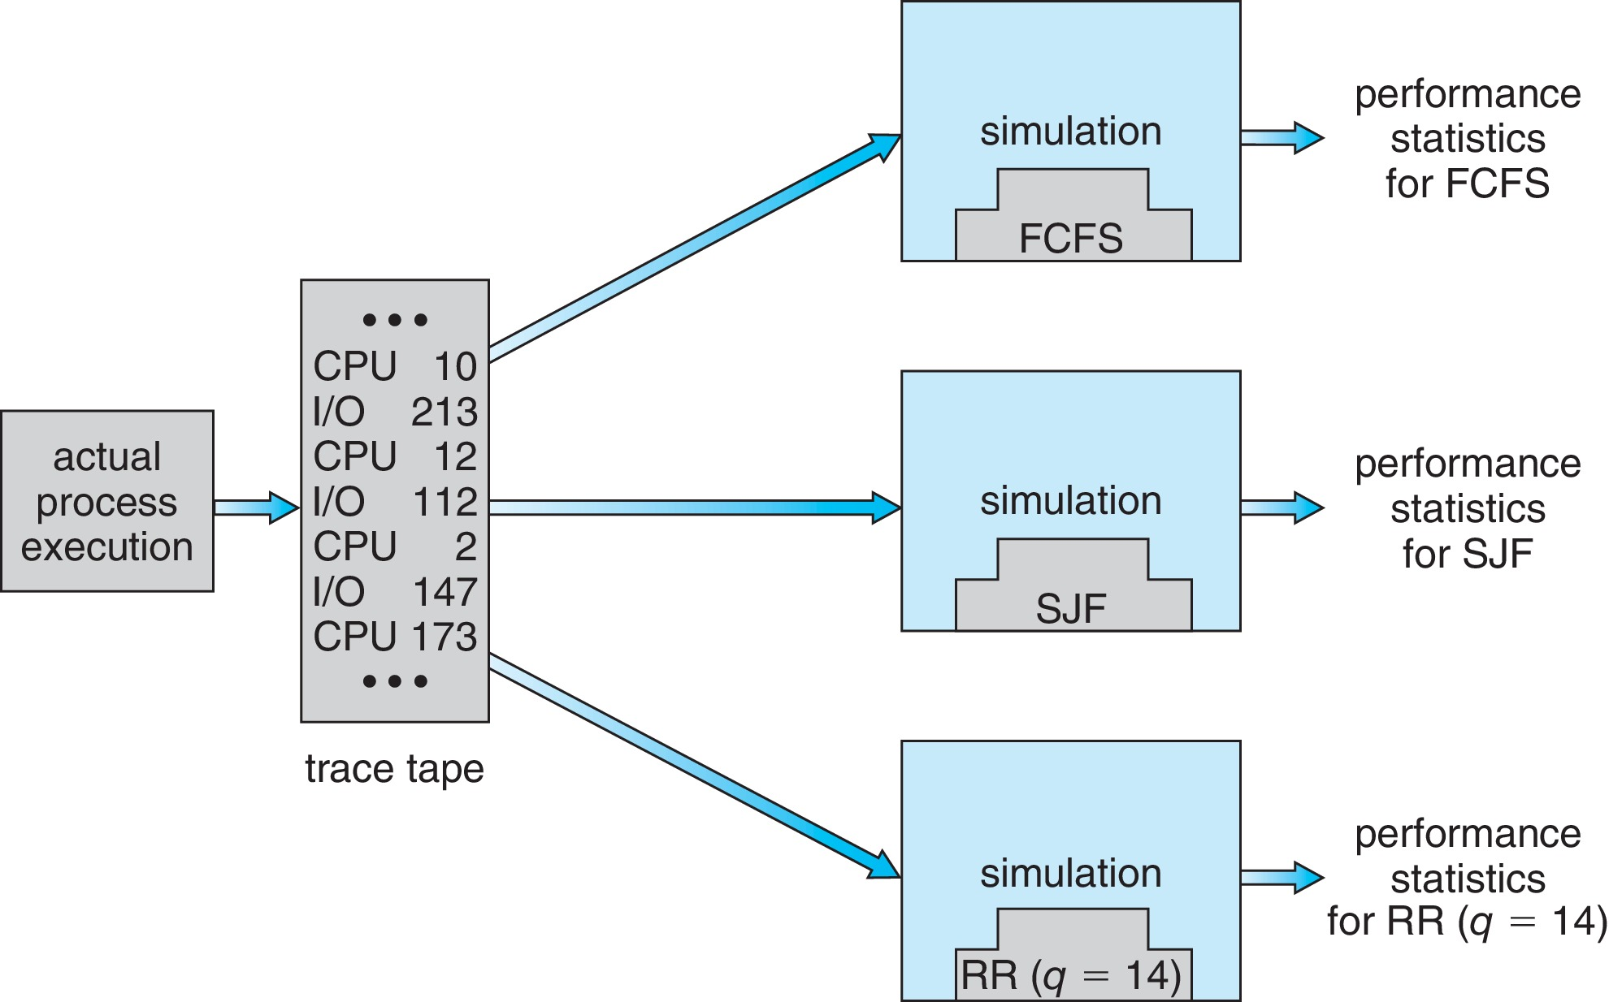
Evaluation of CPU Schedulers by Simulation

Slide 82
Implementation
Even simulations have limited accuracy
Just implement new scheduler and test in real systems
  High cost, high risk
  Environments vary
Most flexible schedulers can be modified per-site or per-system
Or APIs to modify priorities
But again environments vary

Slide 83
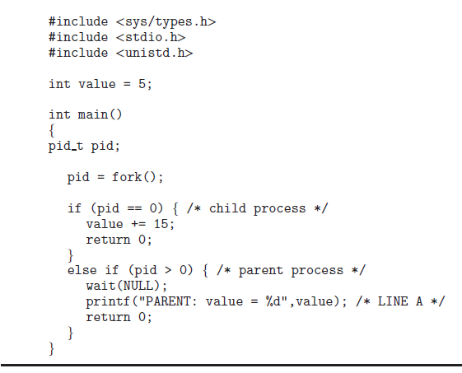
Assessment Qs – o/p at Line A?

Slide 84
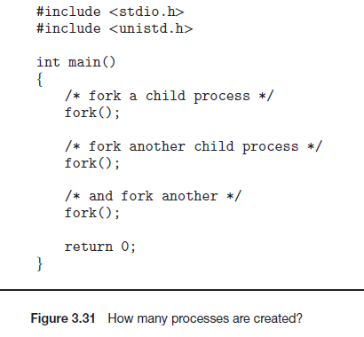
Output?

Slide 85
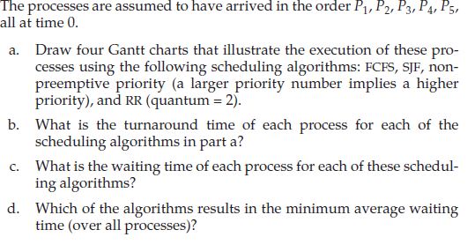
CPU Scheduling

Slide 86
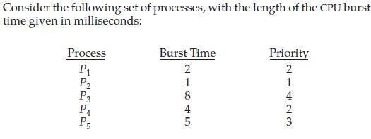
CPU Scheduling

Slide 87
End

